Slide 1


雲端儲存與 永續資訊
戴敏育 副教授 國立臺北大學 資訊管理研究所

Slide 2






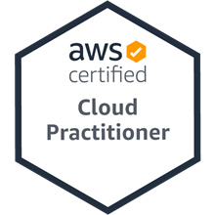

雲端儲存與永續資訊 Cloud Storage and Sustainability Information
2022 ESG 高鋒會 永續資訊揭露案例及雲端儲存
Time: 2022/6/25 (Sat.) 9:40-10:15 Place: 台北世貿一館1樓B區 ESG沙龍 (B536)
戴敏育 副教授
Min-Yuh Day, Ph.D, Associate Professor
國立臺北大學 資訊管理研究所
Institute of Information Management, National Taipei University
https://web.ntpu.edu.tw/~myday
2022-06-25

Slide 3


戴敏育 博士 (Min-Yuh Day, Ph.D.)
1
國立臺北大學 資訊管理研究所 副教授
中央研究院 資訊科學研究所 訪問學人
國立臺灣大學 資訊管理 博士
Publications Co-Chairs, IEEE/ACM International Conference on Advances in Social Networks Analysis and Mining (ASONAM 2013- )
Program Co-Chair, IEEE International Workshop on Empirical Methods for Recognizing Inference in TExt (IEEE EM-RITE 2012- )
Publications Chair, The IEEE International Conference on Information Reuse and Integration for Data Science (IEEE IRI)

Slide 4
Outline
永續資訊雲端架構
AWS Serverless 架構
AWS 雲端儲存 (S3: Simple Storage Service)
AWS Hands-on : Using S3 Service for XBRL Cloud Storage
結論

Slide 5
永續資訊揭露與 XBRL 應用之研究 永續報告XBRL雲端架構之研究
2022/02- 2022/06
計畫主持人：池祥麟 特聘教授，國立臺北大學金融與合作經營學系
共同主持人：王怡心 教授，國立臺北大學會計學系
黃啟瑞 教授，國立臺北大學金融與合作經營學系
戴敏育 副教授，國立臺北大學資訊管理研究所
研究助理： 鄧詠薇，國立臺北大學資訊管理研究所
2022-06-25

Slide 6
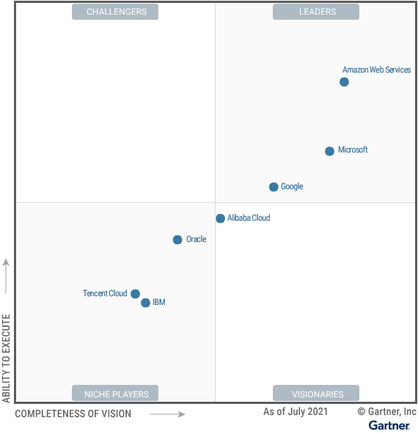
Gartner Magic Quadrant for Cloud Infrastructure and Platform Services
Amazon Web Services
Microsoft
Google
Source: https://www.gartner.com/doc/reprints?id=1-271OE4VR&ct=210802

Slide 7
Software as a service
Software customers
Software provider
Software services
Cloud Infrastructure
Cloud provider

Slide 8
VM
Container
Virtual web server
Virtual mail server
User 1 Container 1
User 2 Container 2
Server software
Server software
Application software
Application software
Guest OS
Guest OS
Server software
Server software
Hypervisor
Container manager
Host OS
Host OS
Server Hardware
Server Hardware

Slide 9
Everything as a service
SASB+XBRL
Application
Software as a service (SaaS)
Logistics management
Cloud management Monitoring
Platform as a service (PaaS)
Database
Software development
Storage Network
Infrastructure as a service (IaaS)
Computing Virtualization
Cloud data center

Slide 10


在 AWS雲端管理 XBRL 服務
XBRL Admin
安裝與操作
更新與補洞
監控
應用
XBRL
主機服務
資料庫
OS Admin
備份還原
網路安全
監控
作業系統
基礎設施
AWS 雲端服務
AWS 全球基礎設施
虛擬主機

Slide 11









永續報告 XBRL 雲端架構圖
關聯式 資料庫
結構化資料
數據分析
Key Value 資料庫
非結構化資料
自動化標記模型訓練
資料儲存
非結構化 資料庫
檔案 物件
系統打包
以利部屬
異常警報監控
人員權限控管
連線主機

Slide 12
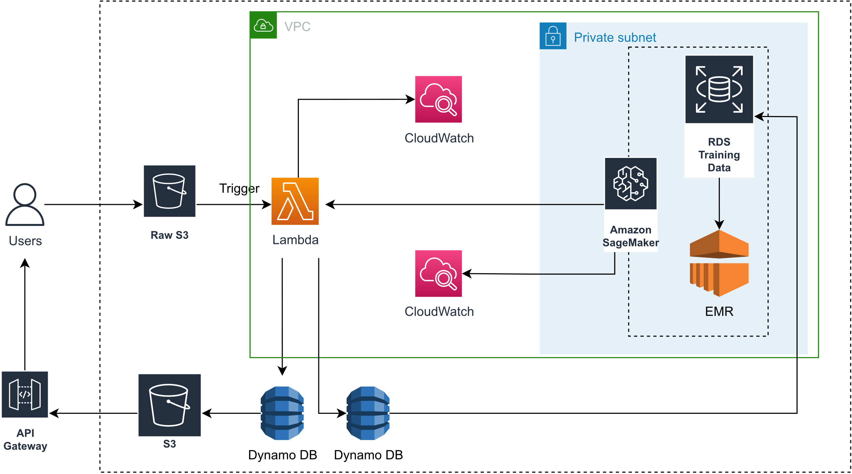
永續報告 XBRL 雲端架構圖 (AWS)
資料來源：This Research

Slide 13
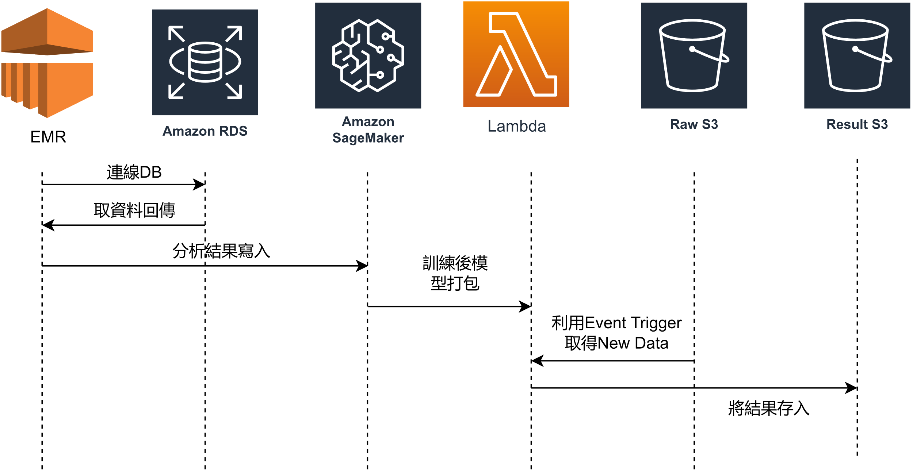
永續報告 XBRL雲端 Sequence Diagram (AWS)
資料來源：This Research

Slide 14

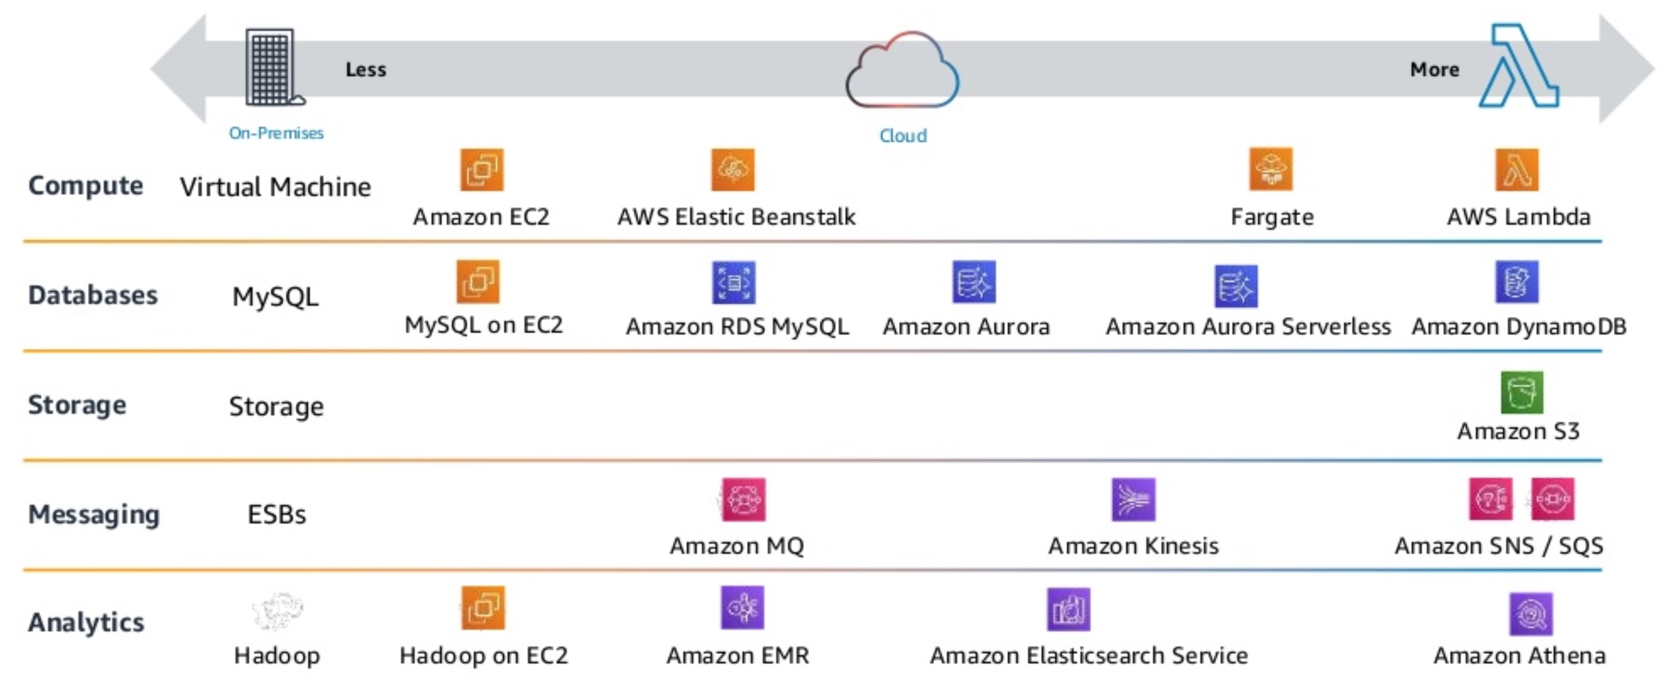
AWS Serverless Architecture AWS Operational Responsibility Models
Source: Heitor Lessa (2019), How to build a full stack serverless airline ticketing web app, https://www.youtube.com/watch?v=MyoOeHTp2pg

Slide 15
AWS Serverless Architecture Cloud Storage: Amazon S3
Source: Heitor Lessa (2019), How to build a full stack serverless airline ticketing web app, https://www.youtube.com/watch?v=MyoOeHTp2pg

Slide 16
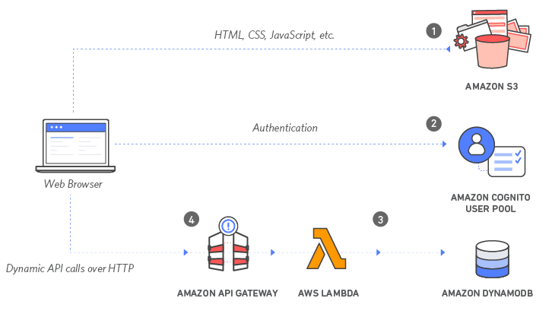
Build a Serverless Web Application with Amazon S3, AWS Lambda, Amazon API Gateway, Amazon DynamoDB, and Amazon Cognito
Source: https://aws.amazon.com/getting-started/projects/build-serverless-web-app-lambda-apigateway-s3-dynamodb-cognito/

Slide 17
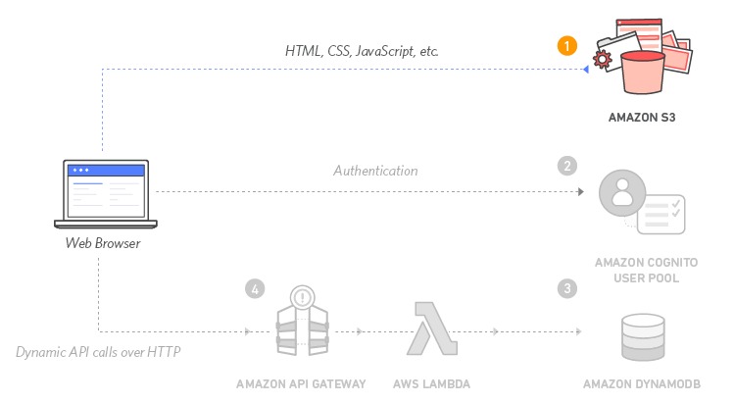
Build a Serverless Web Application with Amazon S3, AWS Lambda, Amazon API Gateway, Amazon DynamoDB, and Amazon Cognito
1
Source: https://aws.amazon.com/getting-started/projects/build-serverless-web-app-lambda-apigateway-s3-dynamodb-cognito/

Slide 18
Build a Serverless Web Application with Amazon S3, AWS Lambda, Amazon API Gateway, Amazon DynamoDB, and Amazon Cognito
1
Static Web Hosting
Amazon S3 hosts static web resources including HTML, CSS, JavaScript, and image files which are loaded in the user's browser.
Source: https://aws.amazon.com/getting-started/projects/build-serverless-web-app-lambda-apigateway-s3-dynamodb-cognito/

Slide 19
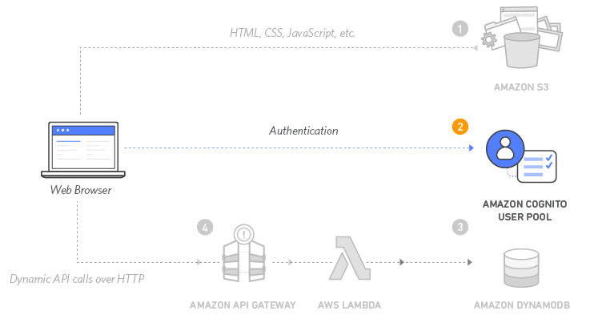
Build a Serverless Web Application with Amazon S3, AWS Lambda, Amazon API Gateway, Amazon DynamoDB, and Amazon Cognito
2
Source: https://aws.amazon.com/getting-started/projects/build-serverless-web-app-lambda-apigateway-s3-dynamodb-cognito/

Slide 20
Build a Serverless Web Application with Amazon S3, AWS Lambda, Amazon API Gateway, Amazon DynamoDB, and Amazon Cognito
2
User Management
Amazon Cognito provides user management and authentication functions to secure the backend API.
Source: https://aws.amazon.com/getting-started/projects/build-serverless-web-app-lambda-apigateway-s3-dynamodb-cognito/

Slide 21
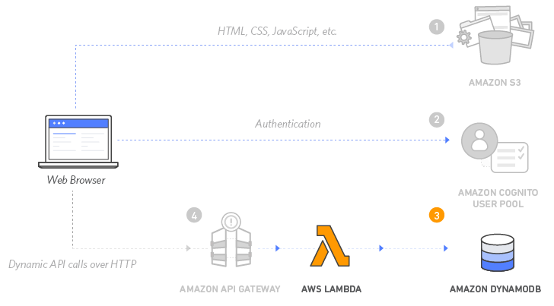
Build a Serverless Web Application with Amazon S3, AWS Lambda, Amazon API Gateway, Amazon DynamoDB, and Amazon Cognito
3
Source: https://aws.amazon.com/getting-started/projects/build-serverless-web-app-lambda-apigateway-s3-dynamodb-cognito/

Slide 22
Build a Serverless Web Application with Amazon S3, AWS Lambda, Amazon API Gateway, Amazon DynamoDB, and Amazon Cognito
3
Serverless Backend
Amazon DynamoDB provides a persistence layer where data can be stored by the API's Lambda function.
Source: https://aws.amazon.com/getting-started/projects/build-serverless-web-app-lambda-apigateway-s3-dynamodb-cognito/

Slide 23
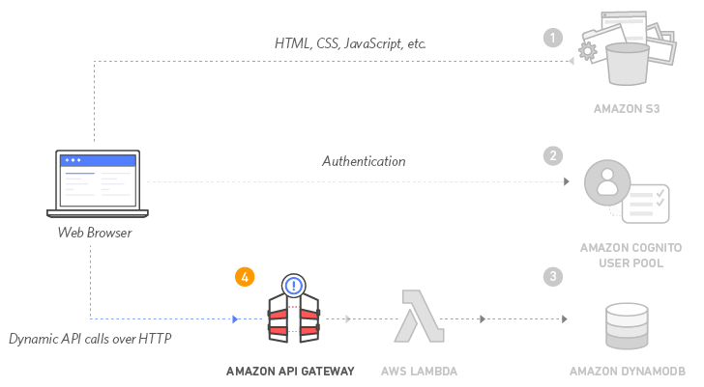
Build a Serverless Web Application with Amazon S3, AWS Lambda, Amazon API Gateway, Amazon DynamoDB, and Amazon Cognito
4
Source: https://aws.amazon.com/getting-started/projects/build-serverless-web-app-lambda-apigateway-s3-dynamodb-cognito/

Slide 24
Build a Serverless Web Application with Amazon S3, AWS Lambda, Amazon API Gateway, Amazon DynamoDB, and Amazon Cognito
4
RESTful API
JavaScript executed in the browser sends and receives data from a public backend API built using Lambda and API Gateway.
Source: https://aws.amazon.com/getting-started/projects/build-serverless-web-app-lambda-apigateway-s3-dynamodb-cognito/

Slide 25
Build a Serverless Web Application with Amazon S3, AWS Lambda, Amazon API Gateway, Amazon DynamoDB, and Amazon Cognito
5
Terminate resources
Resource Cleanup
You will terminate an Amazon S3 bucket, an Amazon Cognito User Pool, an AWS Lambda function, an IAM role, a DynamoDB table, a REST API, and a CloudWatch Log. It is a best practice to delete resources you are no longer using to avoid unwanted charges.
Source: https://aws.amazon.com/getting-started/projects/build-serverless-web-app-lambda-apigateway-s3-dynamodb-cognito/

Slide 26
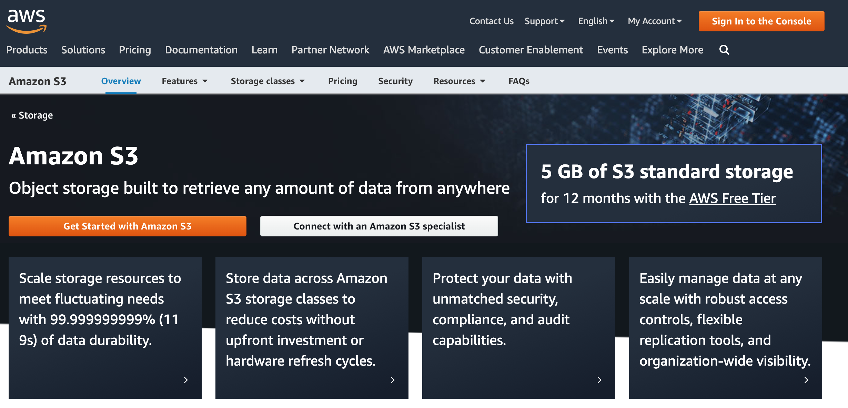
Amazon S3: Simple Storage Service
https://aws.amazon.com/s3/

Slide 27
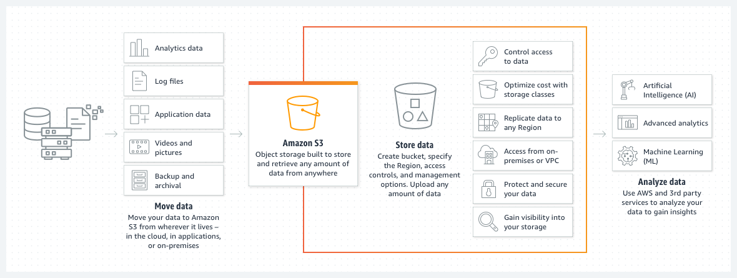
Amazon S3: Simple Storage Service
https://aws.amazon.com/s3/

Slide 28
AWS 雲端儲存 – Amazon S3
是一種物件儲存服務
提供可擴展性、資料可用性、安全性及效能。
可用於建置資料湖，雲端原生應用程式和行動應用程式，以及備份和還原關鍵資料
https://aws.amazon.com/s3/

Slide 29
Amazon S3 與 AWS 服務結合應用
資料處理：使用 AWS Lambda 函數，自動處理標準 S3 GET 請求的輸出，便可講S3與其Lambda 函數做串接
儲存管理與監控：可利用AWS Cloudwatch 來追蹤 AWS S3 儲存資源的操作狀態
存取管理：可結合 IAM，做將存取權授與其他使用，並建置存取控制清單 (ACL)，用來使個別物件可供授權使用者使用
安全性：使用 VPC 端點從 Amazon Virtual Private Cloud (Amazon VPC) 和內部部署連接至 S3 資源，針對上傳資料，Amazon S3 同時支援伺服器端加密 (具有三個金鑰管理選項) 和用戶端加密
https://aws.amazon.com/s3/

Slide 30

AWS Hands-on : Using S3 Service for XBRL Cloud Storage

Slide 31
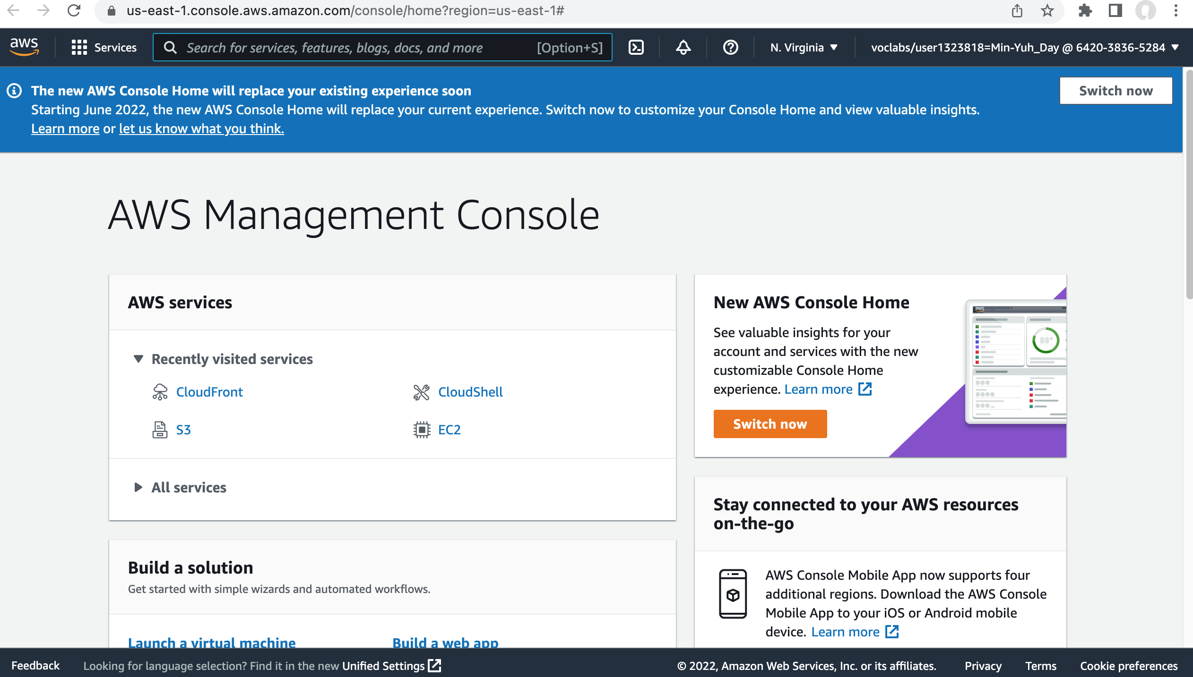
AWS Hands-on : Using S3 Service for XBRL Cloud Storage
Source: AWS Academy Introduction to Cloud: Semester 1, https://awsacademy.instructure.com/courses/18745

Slide 32
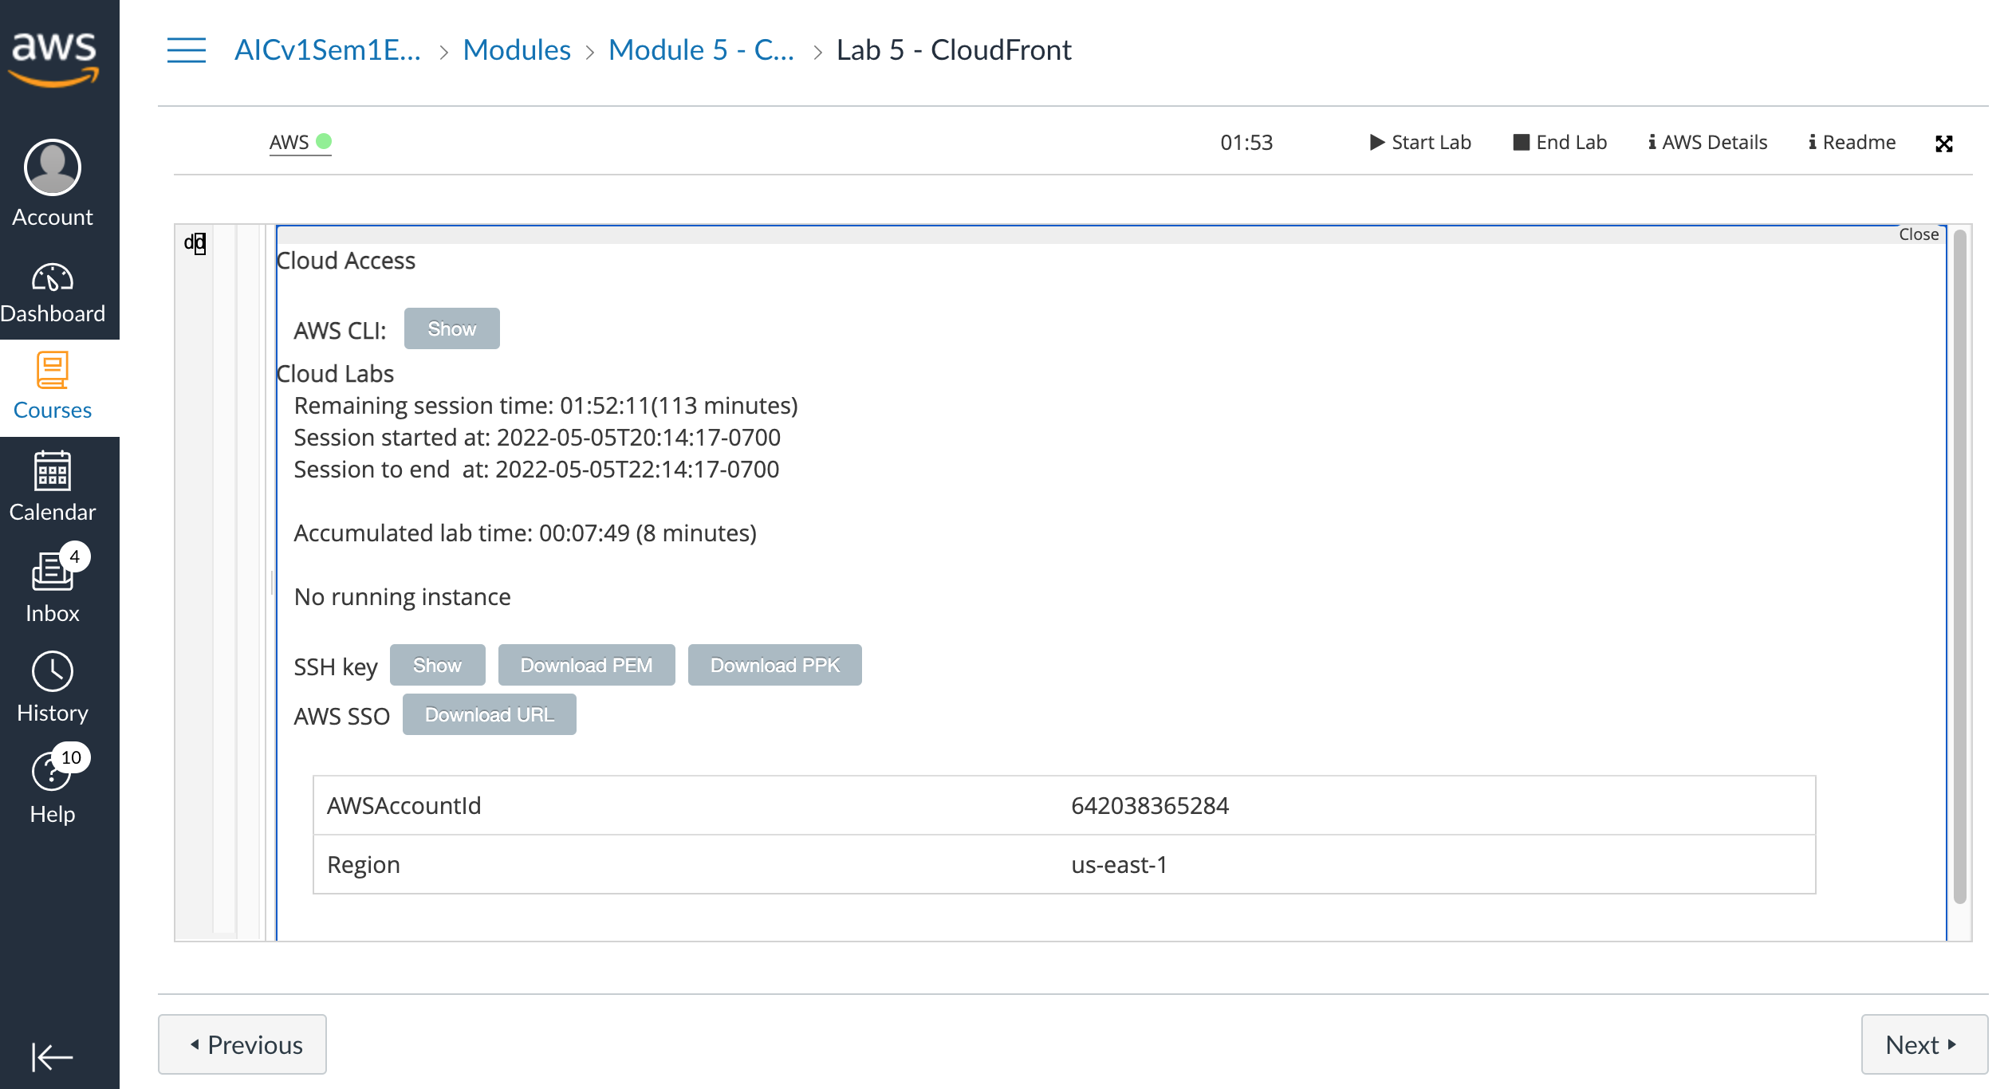
AWS Hands-on : Using S3 Service for XBRL Cloud Storage
Source: AWS Academy Introduction to Cloud: Semester 1, https://awsacademy.instructure.com/courses/18745

Slide 33
AWS Hands-on : Using S3 Service for XBRL Cloud Storage
Task 1. Create an S3 bucket using the AWS CLI
4. Choose the Services menu, locate the Developer Tools services, and select CloudShell.
If a welcome pop-up window appears, choose Close.
AWS CloudShell is a browser-based shell that gives you command line access to your AWS resources in the selected AWS Region.
5. Copy and paste the following code into a text editor:
cd ~
aws s3api create-bucket --bucket (bucket-name) --region us-east-1
cd ~
aws s3api create-bucket --bucket sasb-xbrl-2330 --region us-east-1
6. In the code that you copied, replace (bucket-name) with a unique Domain Name System (DNS)-compliant name for your new bucket.
7. Run the updated code in the CloudShell terminal.
If a pop-up window appears, choose Paste.
The output should look similar to the following:
{
"Location": "/mylabbucket12345”
}
Source: AWS Academy Introduction to Cloud: Semester 1, https://awsacademy.instructure.com/courses/18745

Slide 34
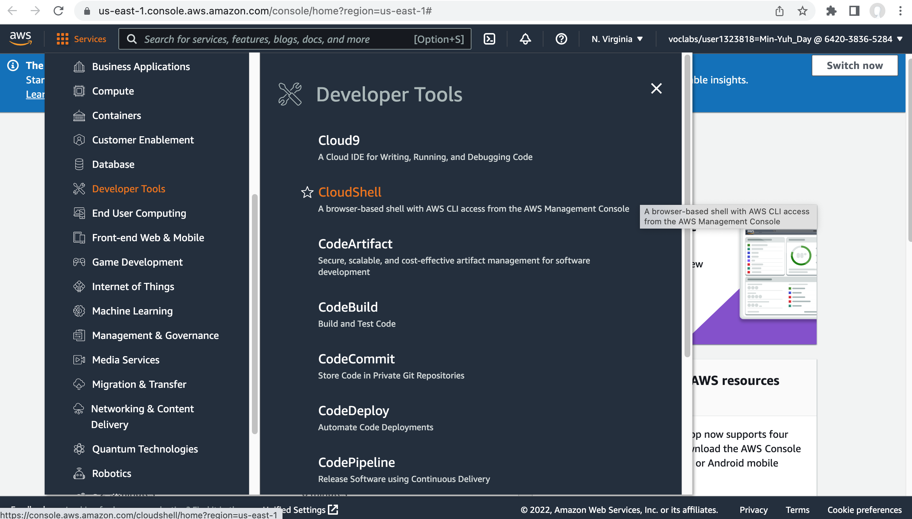
AWS Hands-on : Using S3 Service for XBRL Cloud Storage
4
Task 1. Create an S3 bucket using the AWS CLI
4. Choose the Services menu, locate the Developer Tools services, and select CloudShell.
If a welcome pop-up window appears, choose Close.
AWS CloudShell is a browser-based shell that gives you command line access to your AWS resources in the selected AWS Region.
Source: AWS Academy Introduction to Cloud: Semester 1, https://awsacademy.instructure.com/courses/18745

Slide 35
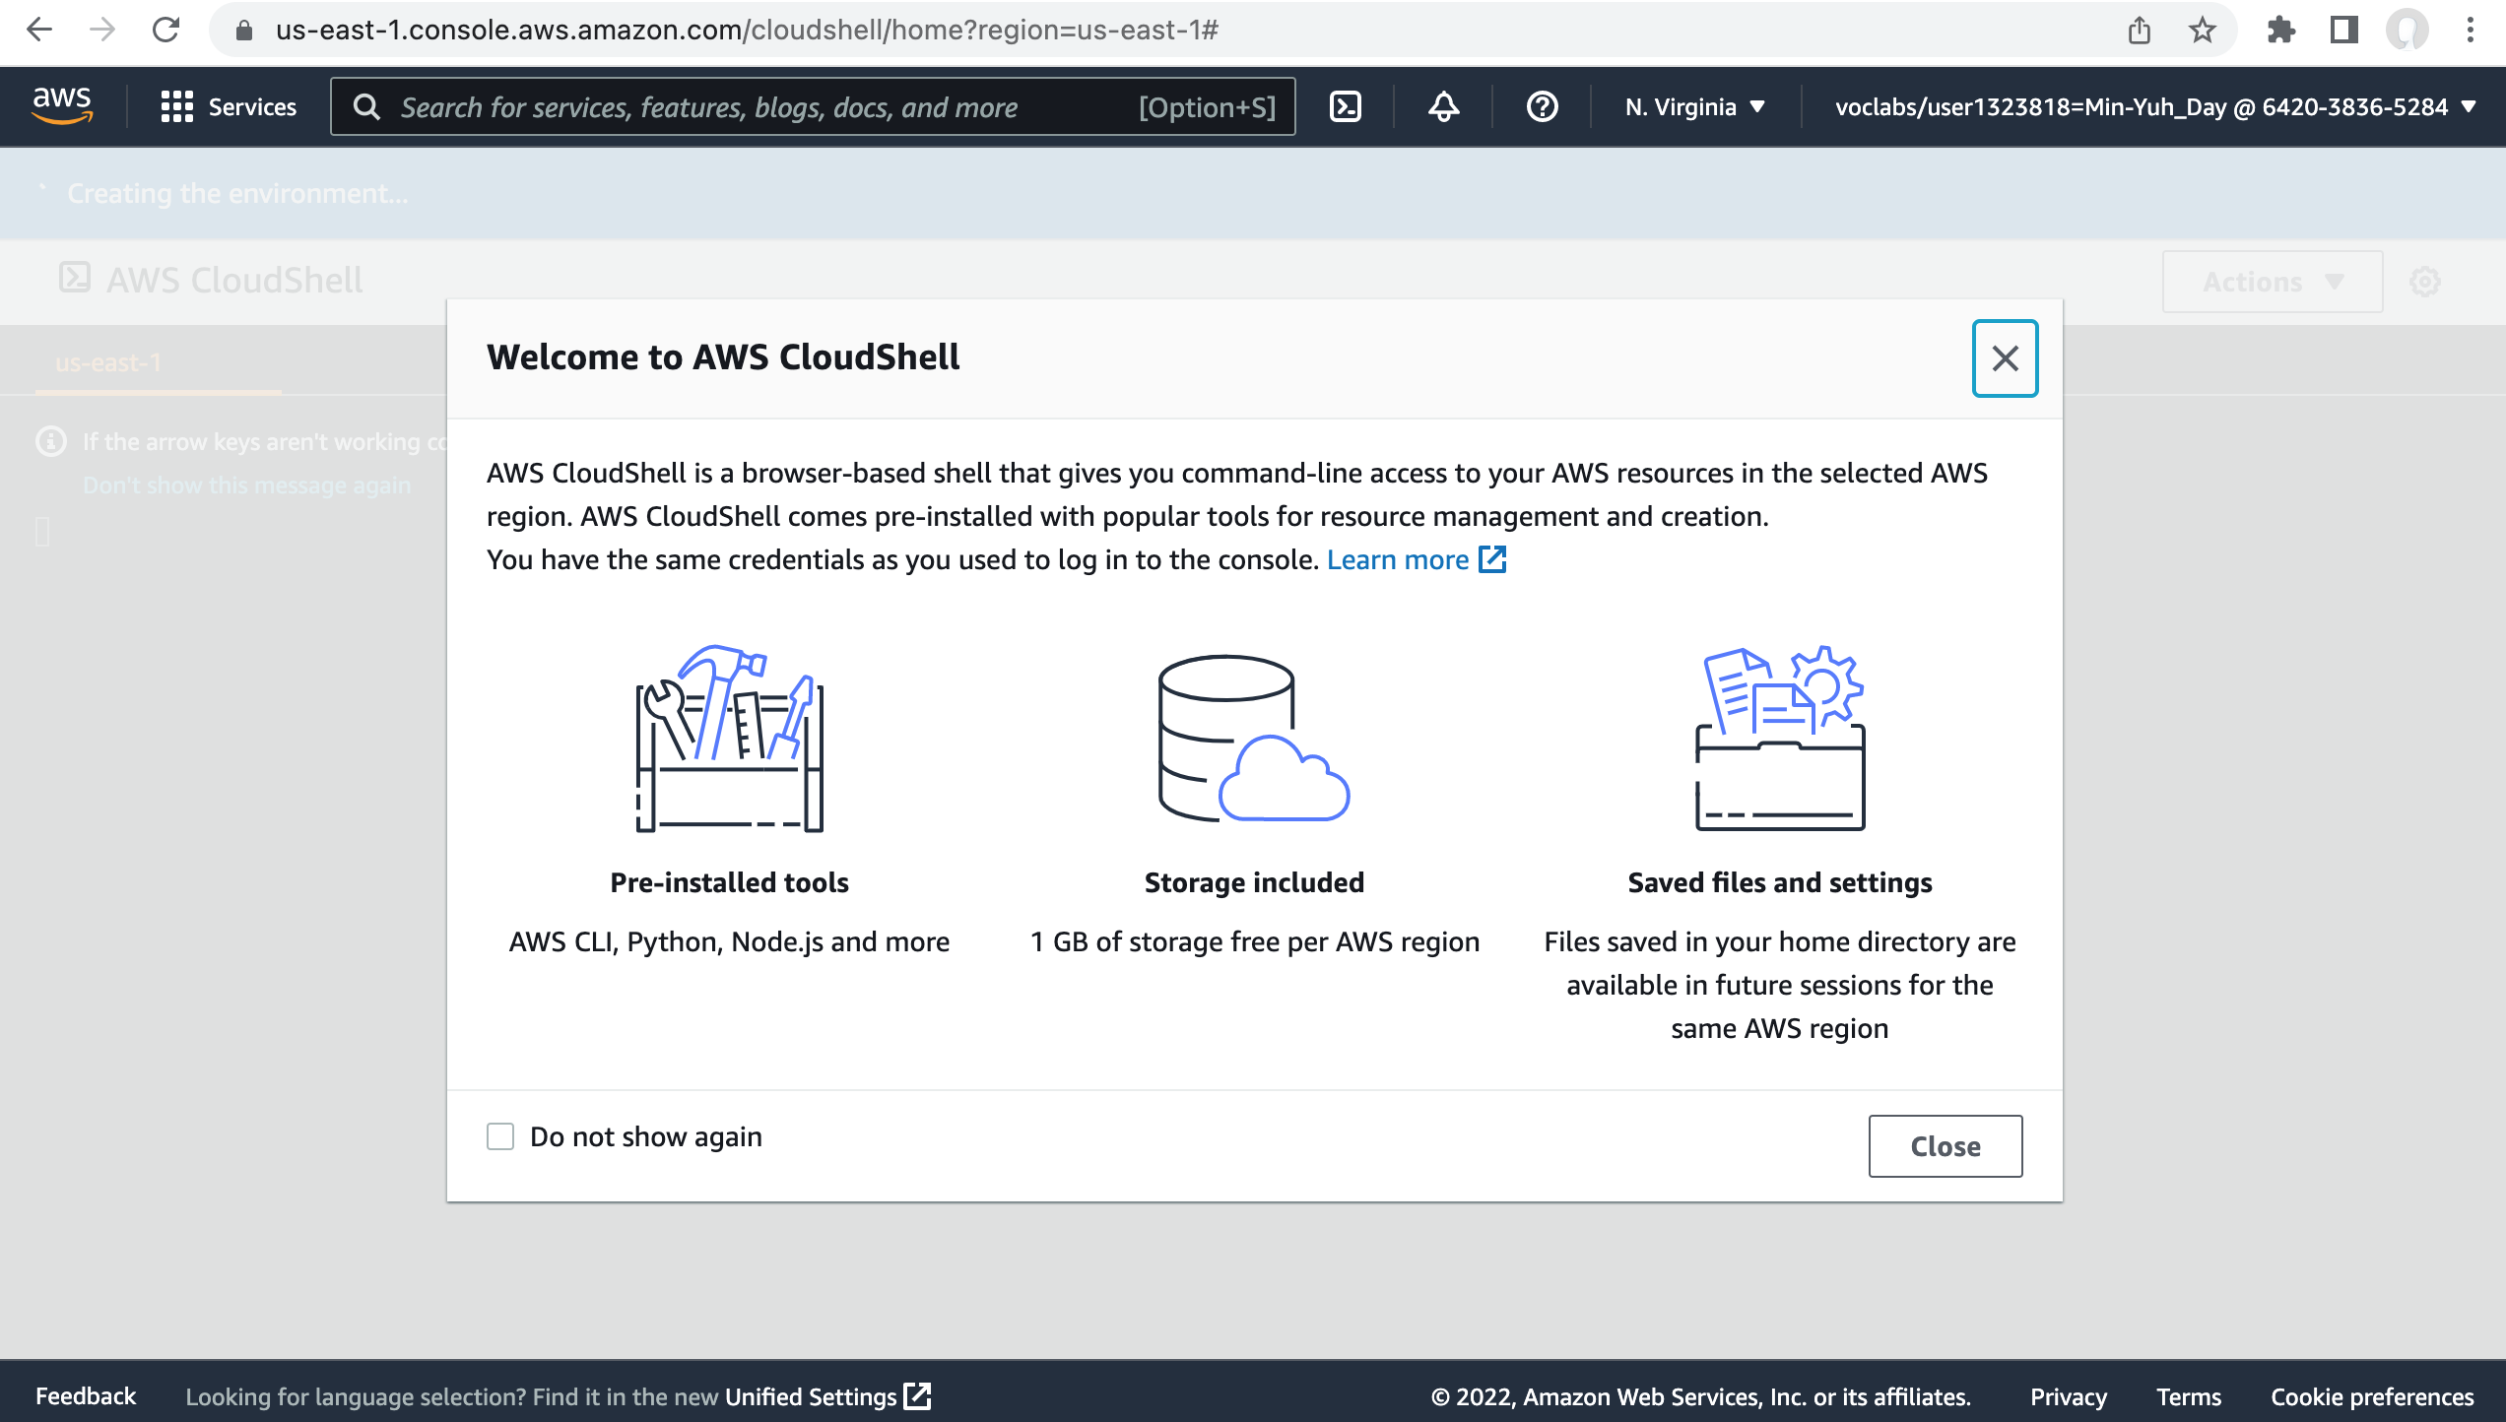
AWS Hands-on : Using S3 Service for XBRL Cloud Storage
Source: AWS Academy Introduction to Cloud: Semester 1, https://awsacademy.instructure.com/courses/18745

Slide 36
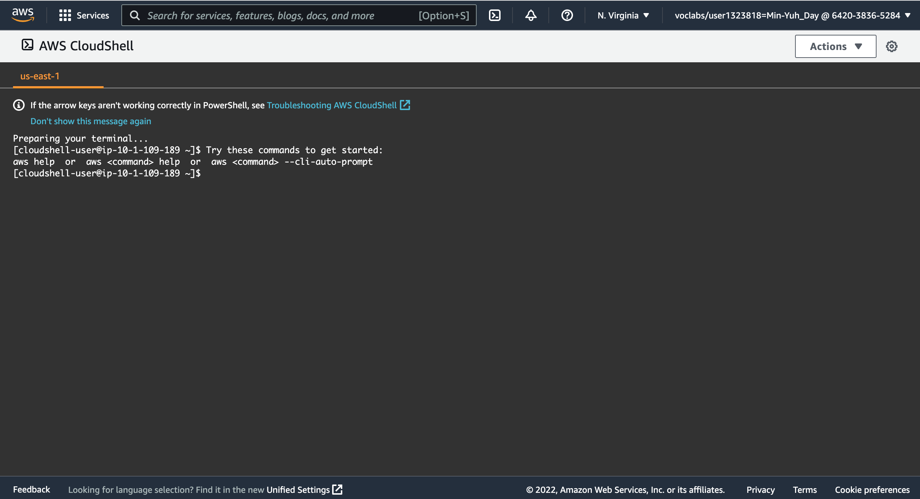
AWS Hands-on : Using S3 Service for XBRL Cloud Storage
5
5. Copy and paste the following code into a text editor:
cd ~
aws s3api create-bucket --bucket (bucket-name) --region us-east-1
Source: AWS Academy Introduction to Cloud: Semester 1, https://awsacademy.instructure.com/courses/18745

Slide 37
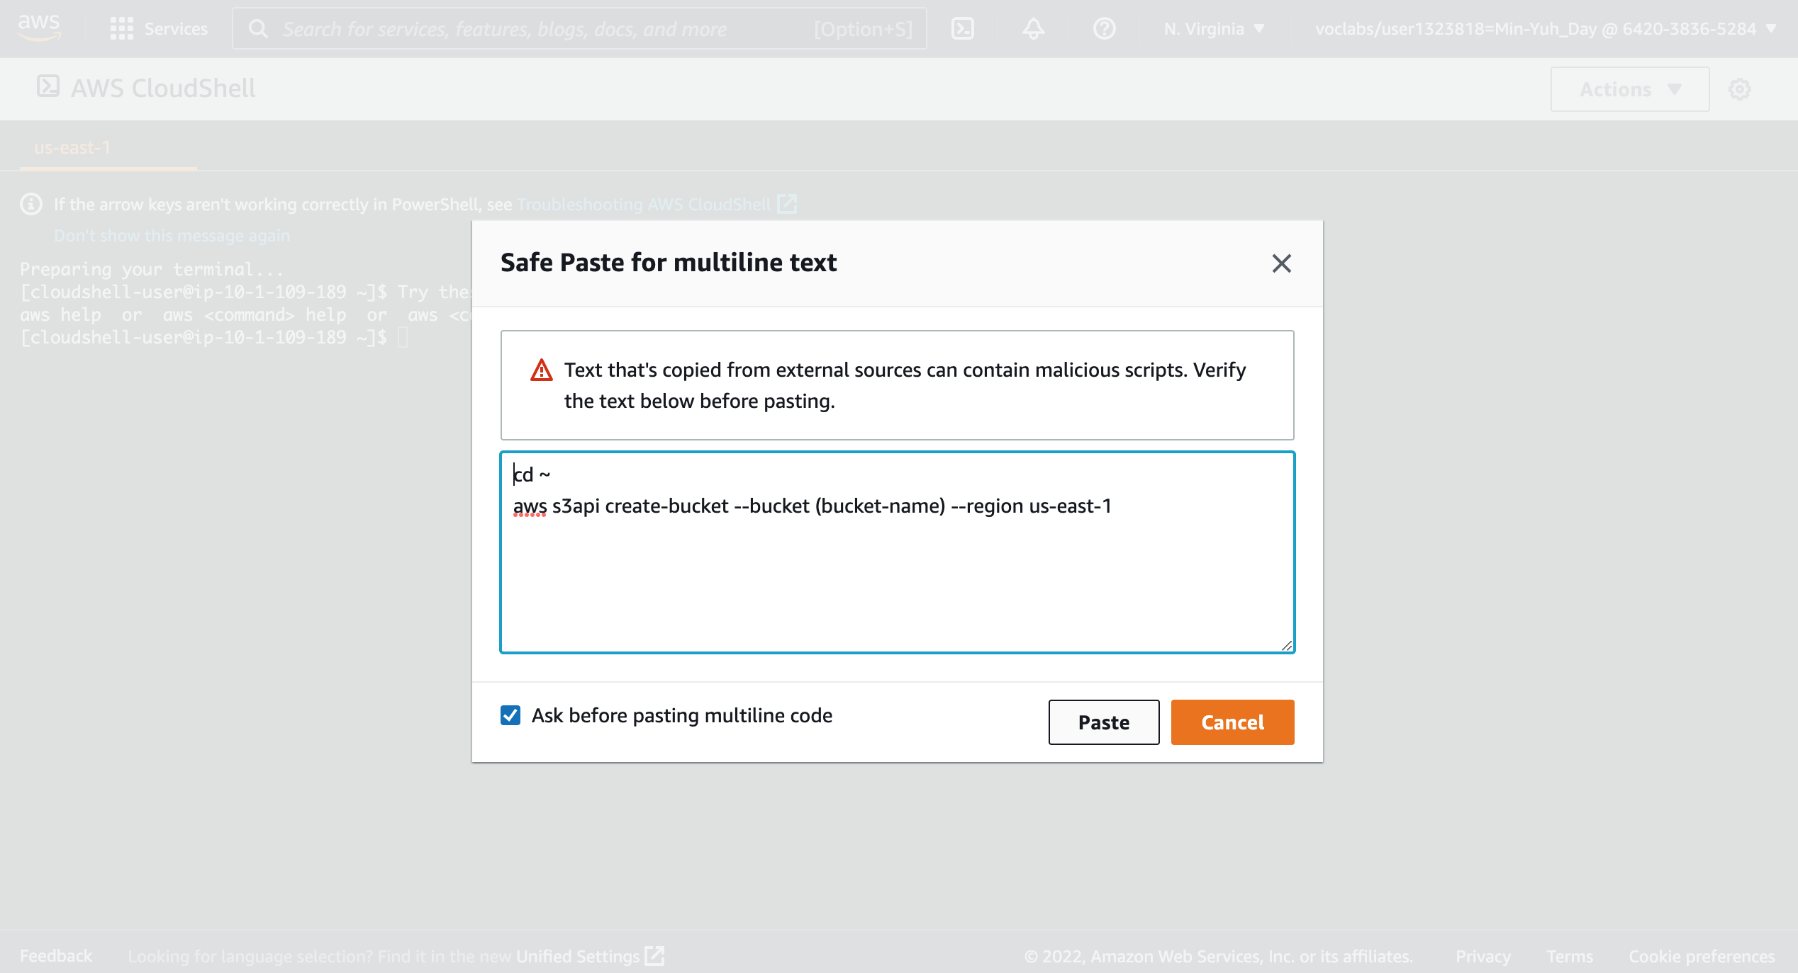
AWS Hands-on : Using S3 Service for XBRL Cloud Storage
5
5. Copy and paste the following code into a text editor:
cd ~
aws s3api create-bucket --bucket (bucket-name) --region us-east-1
Source: AWS Academy Introduction to Cloud: Semester 1, https://awsacademy.instructure.com/courses/18745

Slide 38
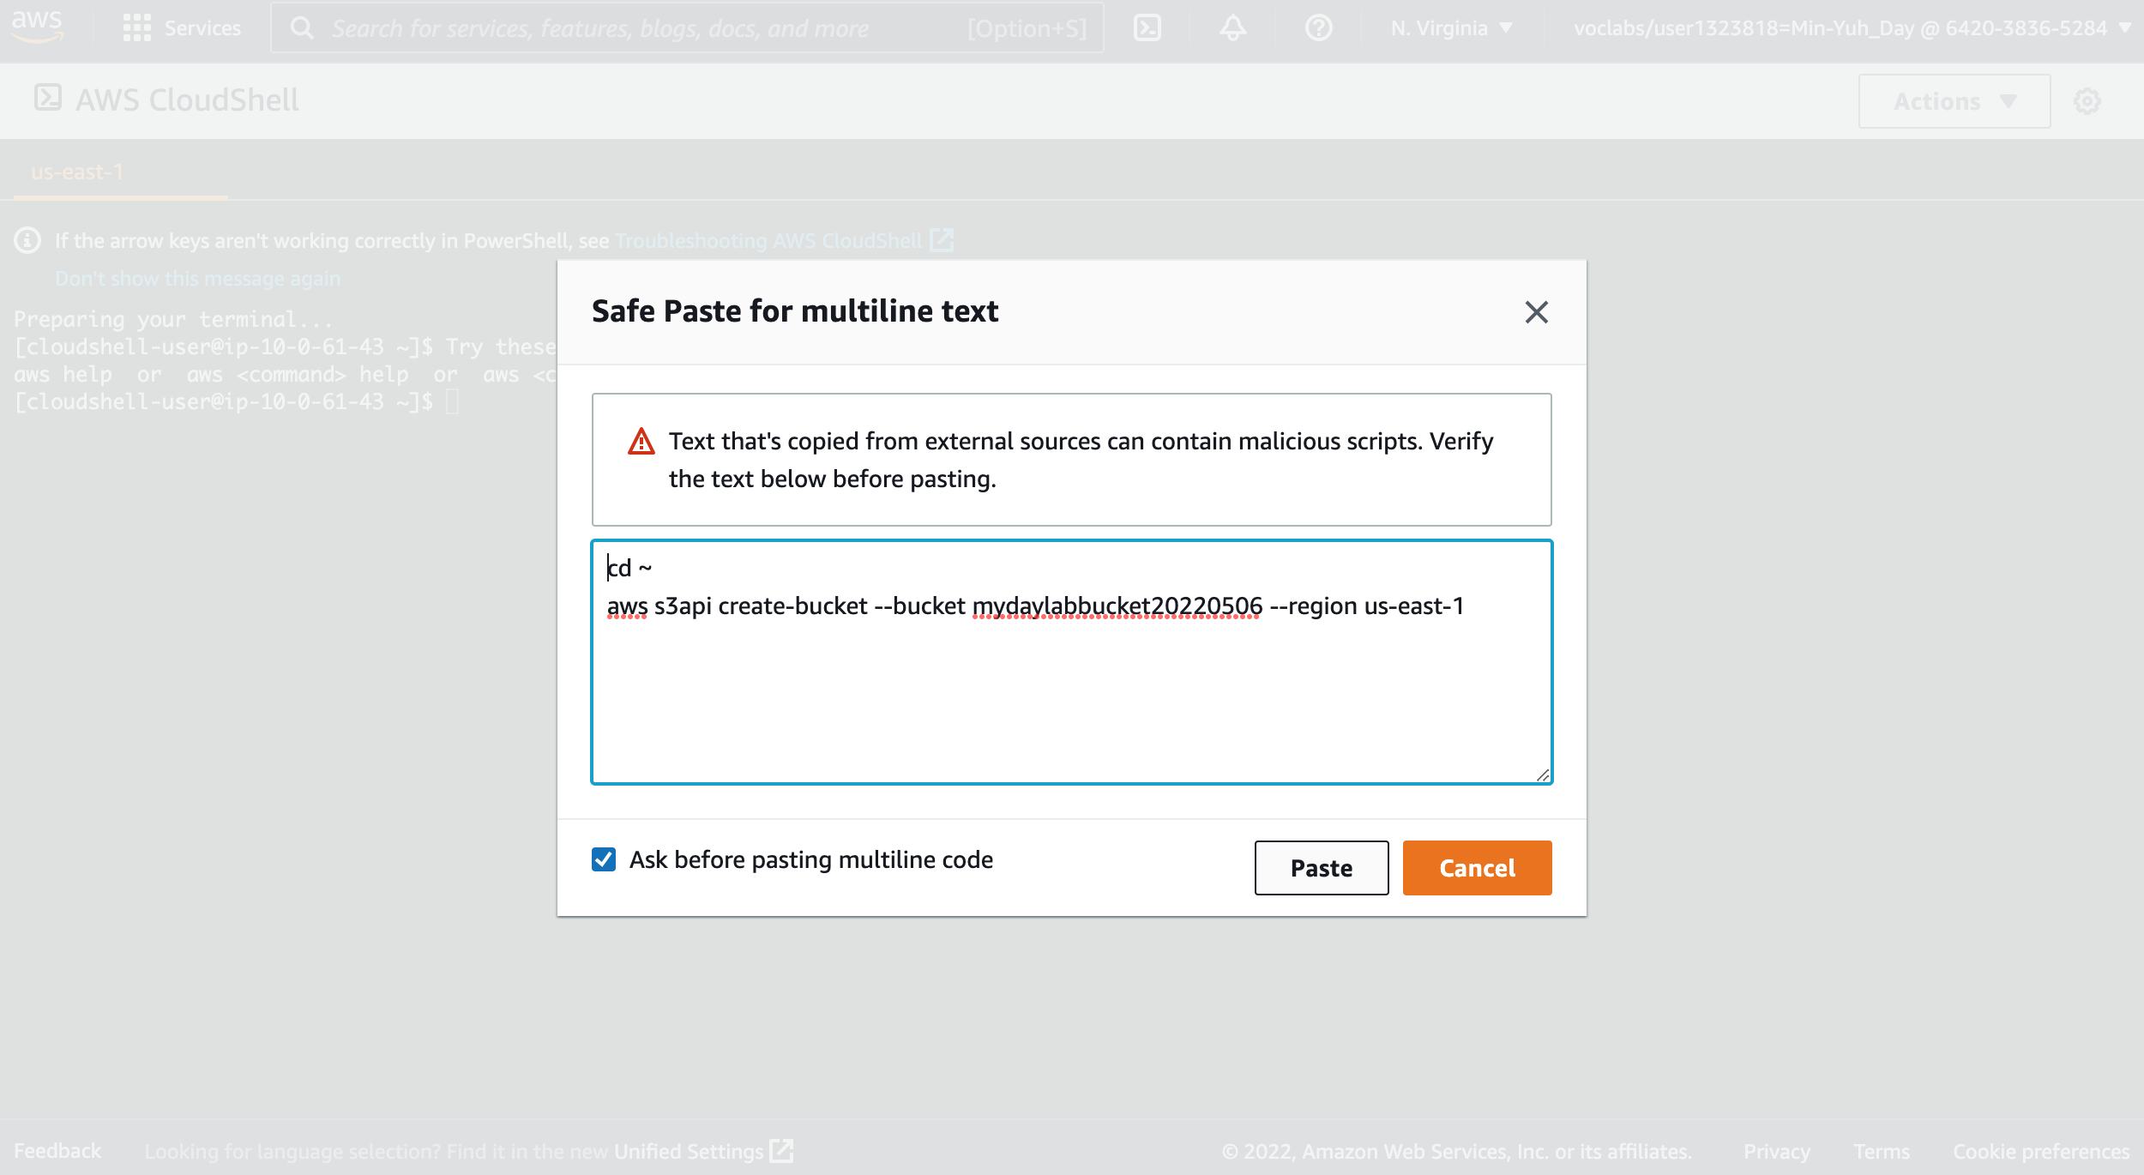
AWS Hands-on : Using S3 Service for XBRL Cloud Storage
6
7
5. Copy and paste the following code into a text editor:
cd ~
aws s3api create-bucket --bucket (bucket-name) --region us-east-1
5. Copy and paste the following code into a text editor:
cd ~
aws s3api create-bucket --bucket sasb-xbrl-2330 --region us-east-1
Source: AWS Academy Introduction to Cloud: Semester 1, https://awsacademy.instructure.com/courses/18745

Slide 39
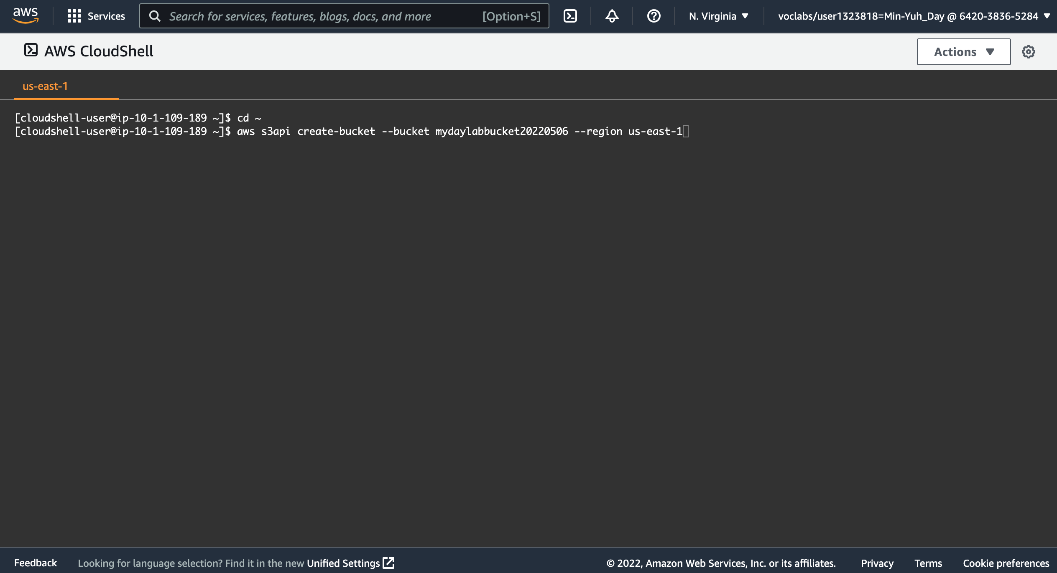
AWS Hands-on : Using S3 Service for XBRL Cloud Storage
5. Copy and paste the following code into a text editor:
cd ~
aws s3api create-bucket --bucket (bucket-name) --region us-east-1
5. Copy and paste the following code into a text editor:
cd ~
aws s3api create-bucket --bucket sasb-xbrl-2330 --region us-east-1
Source: AWS Academy Introduction to Cloud: Semester 1, https://awsacademy.instructure.com/courses/18745

Slide 40
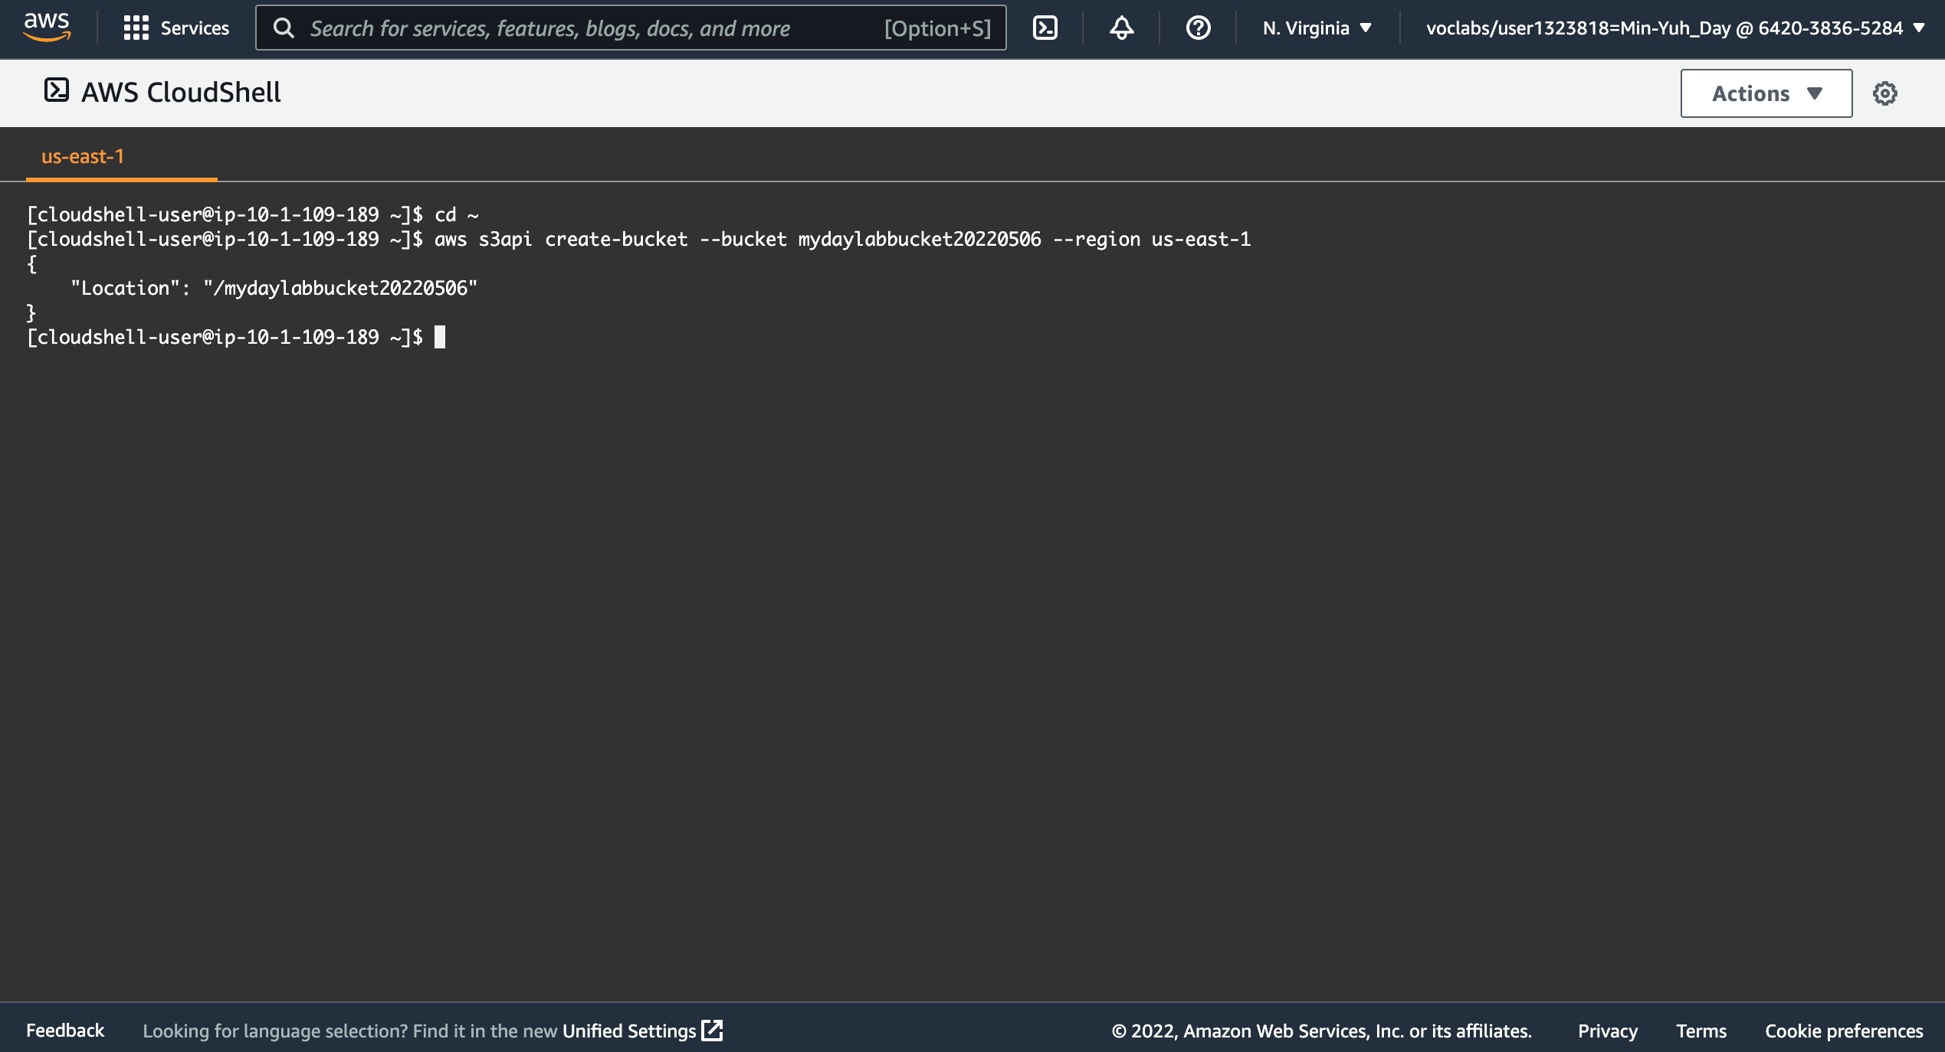
AWS Hands-on : Using S3 Service for XBRL Cloud Storage
6
(bucket-name)
sasb-xbrl-2022q1-2330
7
5. Copy and paste the following code into a text editor:
cd ~
aws s3api create-bucket --bucket sasb-xbrl-2330 --region us-east-1
6. In the code that you copied, replace (bucket-name) with a unique Domain Name System (DNS)-compliant name for your new bucket.
7. Run the updated code in the CloudShell terminal.
If a pop-up window appears, choose Paste.
The output should look similar to the following:
{
"Location": "/mylabbucket12345”
}
Source: AWS Academy Introduction to Cloud: Semester 1, https://awsacademy.instructure.com/courses/18745

Slide 41
AWS Hands-on : Using S3 Service for XBRL Cloud Storage
Task 2. Add a bucket policy
In this task, you will add a bucket policy through the AWS CLI to make the content publicly available.
In the console, choose the Services menu, locate the Storage section, and choose S3.
Choose the name of the bucket that you just created.
Choose the Permissions tab.
In the Bucket policy section, choose Edit.
To grant public read access for your website, copy and paste the following bucket policy into the policy editor.
In the policy, replace example-bucket with the name of your bucket.
At the bottom of the page, choose Save changes.
{
"Version":"2012-10-17",
"Statement":[
{
"Sid":"PublicReadForGetBucketObjects",
"Effect":"Allow",
"Principal":"*",
"Action":[
"s3:GetObject"
],
"Resource":[
"arn:aws:s3:::example-bucket/*"
]
}
]
}
Source: AWS Academy Introduction to Cloud: Semester 1, https://awsacademy.instructure.com/courses/18745

Slide 42
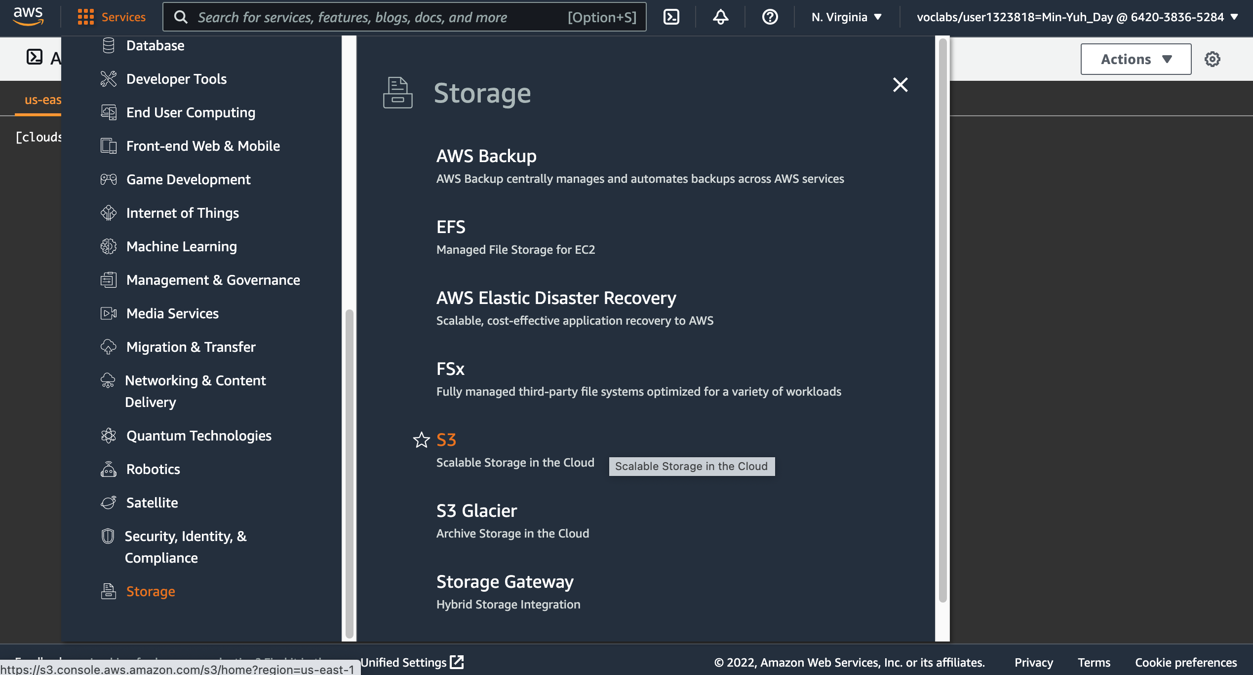
AWS Hands-on : Using S3 Service for XBRL Cloud Storage
8
8
8
In the console, choose the Services menu, locate the Storage section, and choose S3.
Source: AWS Academy Introduction to Cloud: Semester 1, https://awsacademy.instructure.com/courses/18745

Slide 43
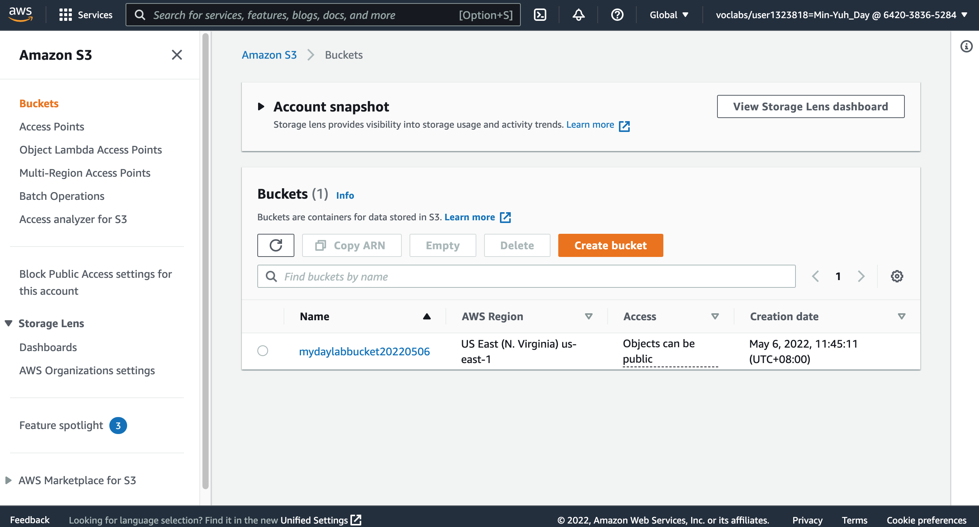
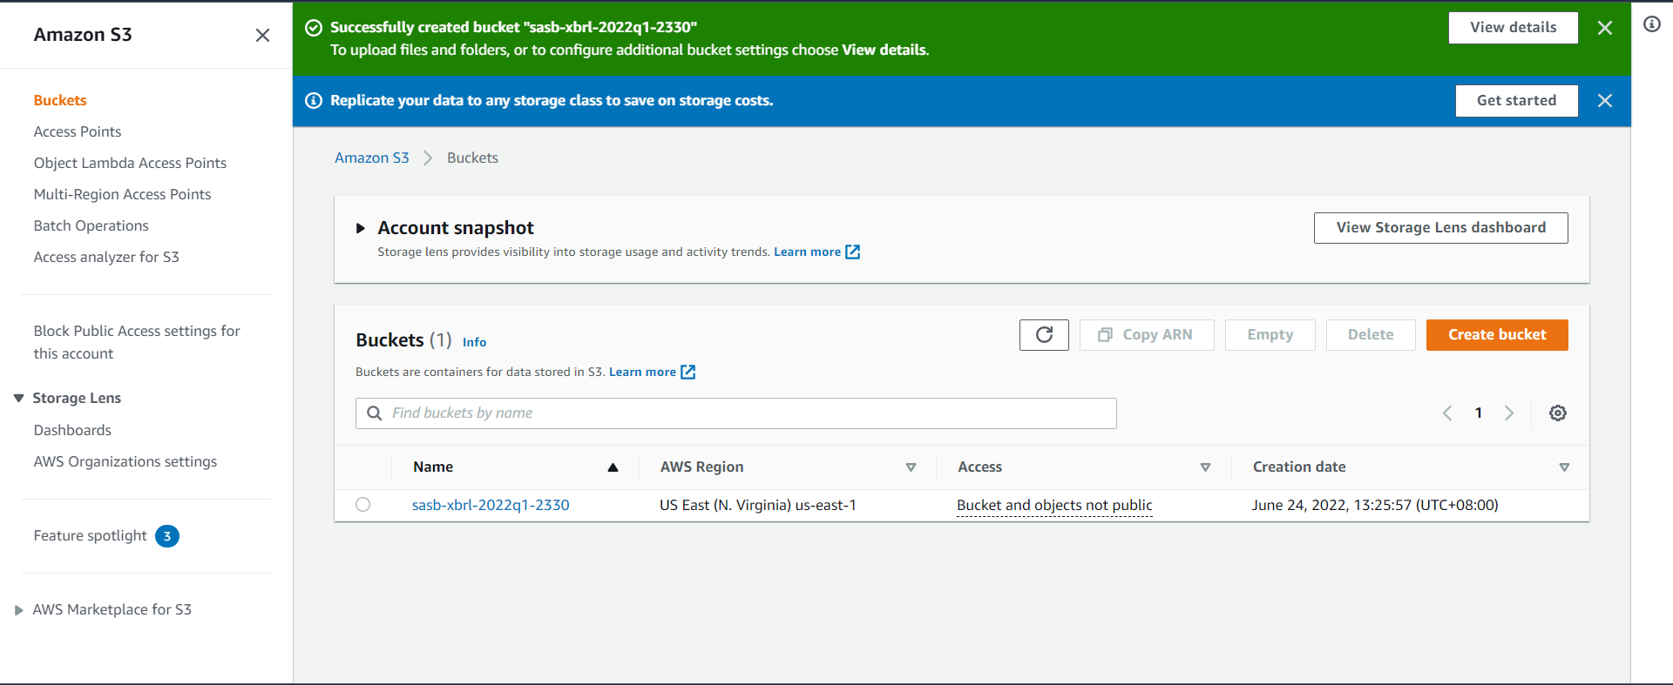
AWS Hands-on : Using S3 Service for XBRL Cloud Storage
9
9. Choose the name of the bucket that you just created.
Source: AWS Academy Introduction to Cloud: Semester 1, https://awsacademy.instructure.com/courses/18745

Slide 44
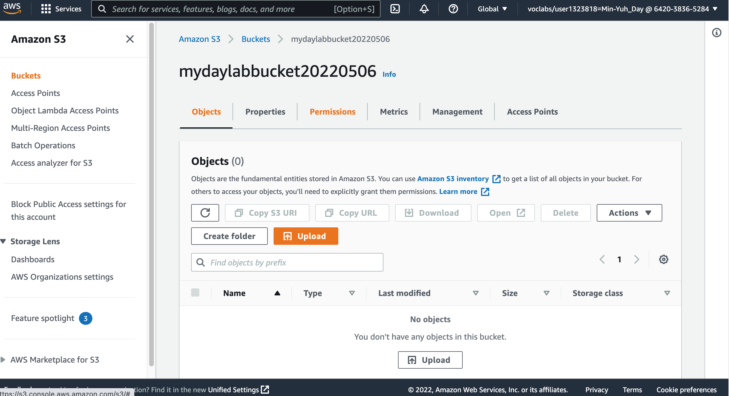
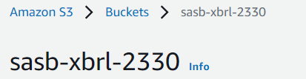
AWS Hands-on : Using S3 Service for XBRL Cloud Storage
10
10. Choose the Permissions tab
Source: AWS Academy Introduction to Cloud: Semester 1, https://awsacademy.instructure.com/courses/18745

Slide 45
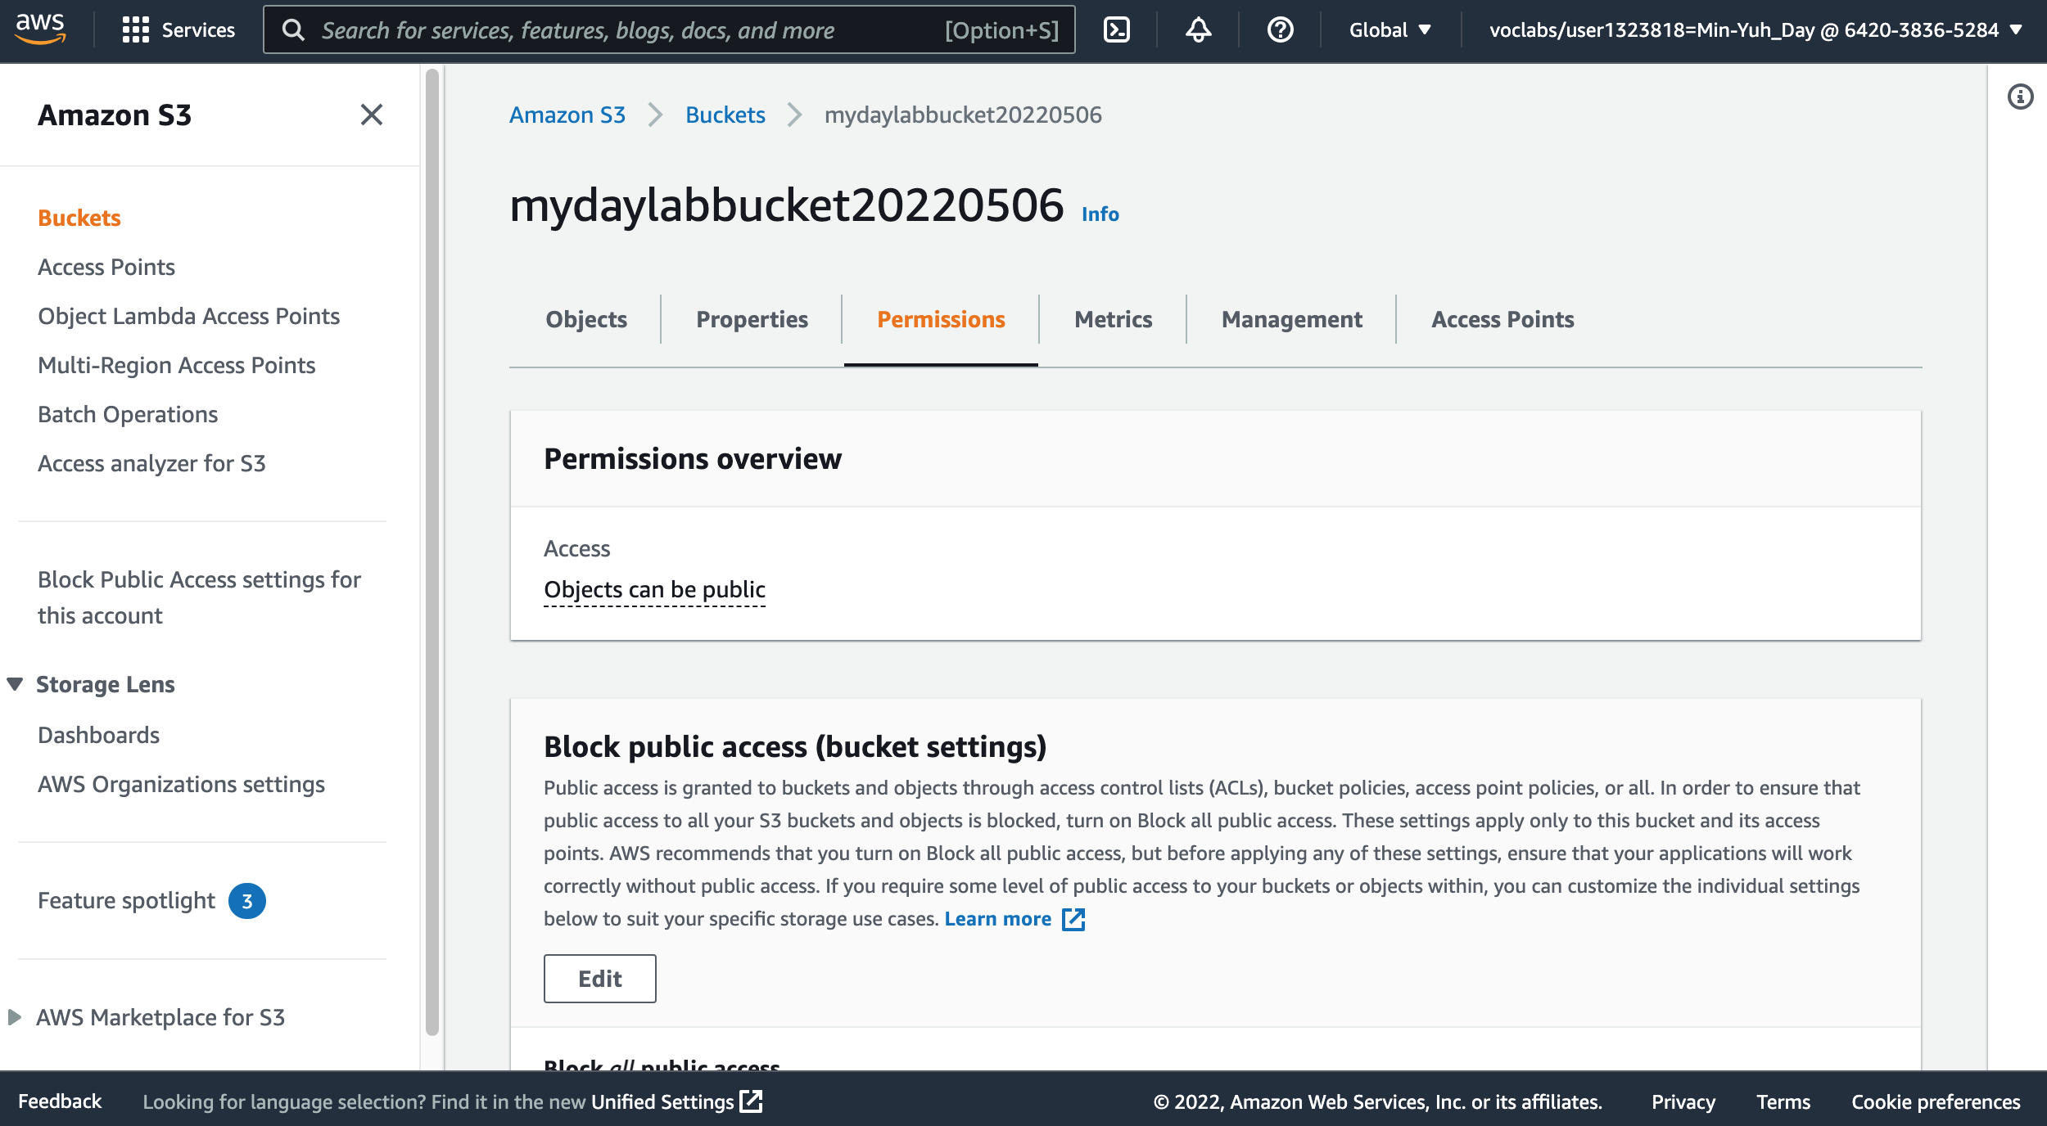
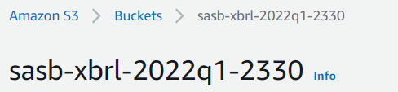
AWS Hands-on : Using S3 Service for XBRL Cloud Storage
10
10. Choose the Permissions tab
Source: AWS Academy Introduction to Cloud: Semester 1, https://awsacademy.instructure.com/courses/18745

Slide 46
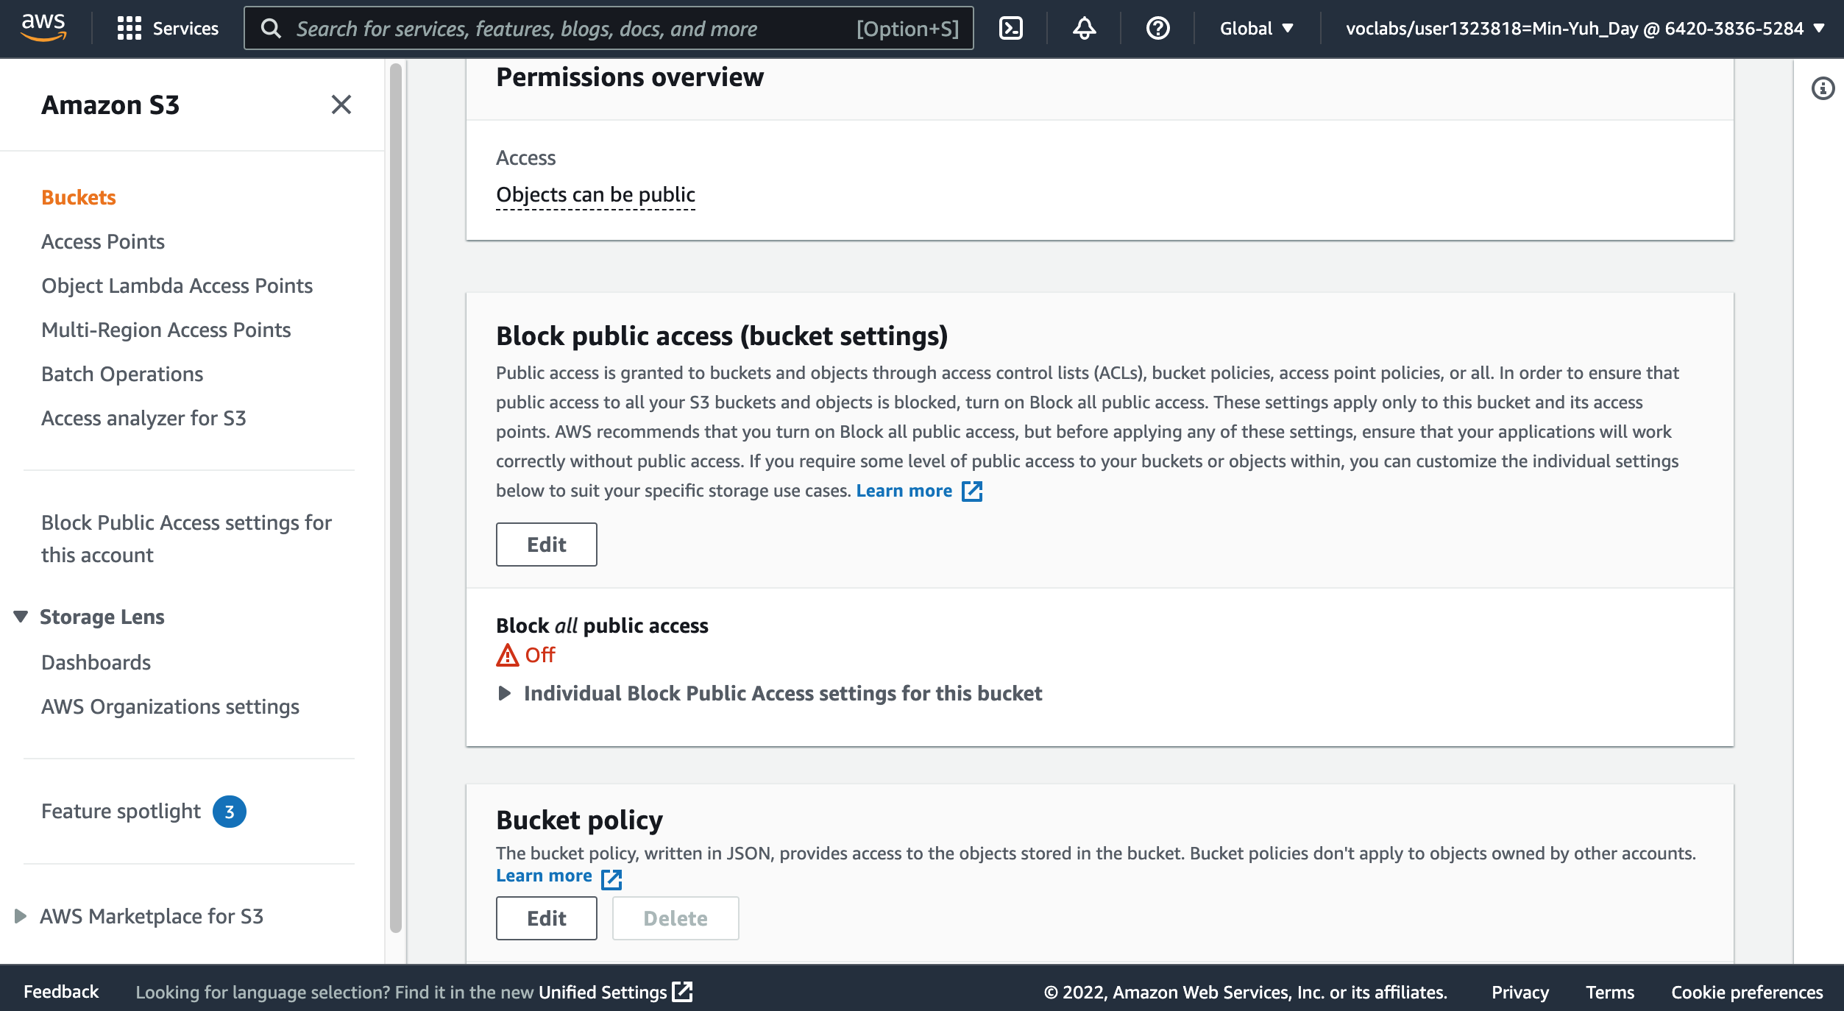
AWS Hands-on : Using S3 Service for XBRL Cloud Storage
11
11. In the Bucket policy section, choose Edit.
Source: AWS Academy Introduction to Cloud: Semester 1, https://awsacademy.instructure.com/courses/18745

Slide 47
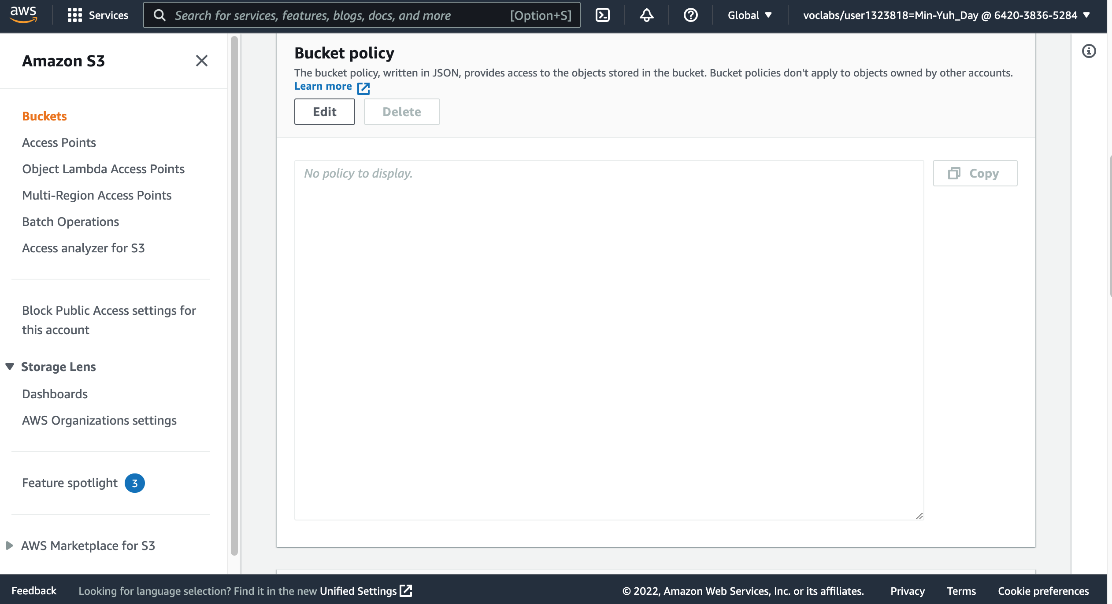
AWS Hands-on : Using S3 Service for XBRL Cloud Storage
11
11. In the Bucket policy section, choose Edit.
Source: AWS Academy Introduction to Cloud: Semester 1, https://awsacademy.instructure.com/courses/18745

Slide 48
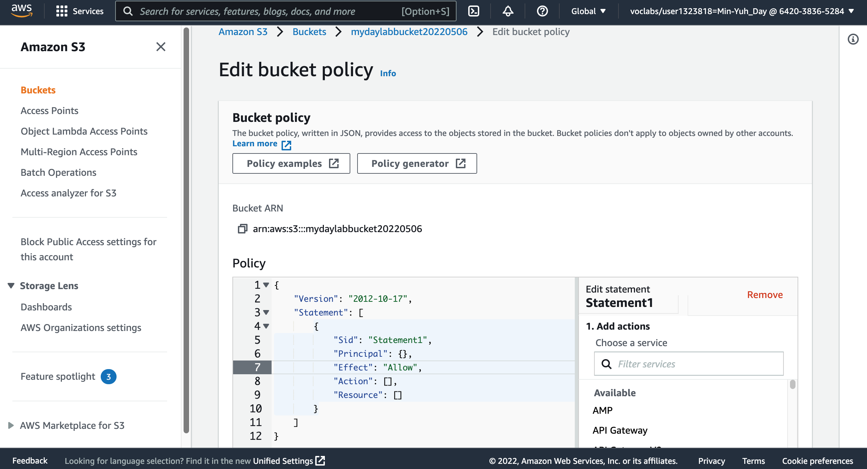
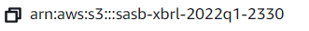
AWS Hands-on : Using S3 Service for XBRL Cloud Storage
12
12. To grant public read access for your website, copy and paste the following bucket policy into the policy editor.
{
"Version":"2012-10-17",
"Statement":[
{
"Sid":"PublicReadForGetBucketObjects",
"Effect":"Allow",
"Principal":"*",
"Action":[
"s3:GetObject"
],
"Resource":[
"arn:aws:s3:::example-bucket/*"
]
}
]
}
Source: AWS Academy Introduction to Cloud: Semester 1, https://awsacademy.instructure.com/courses/18745

Slide 49
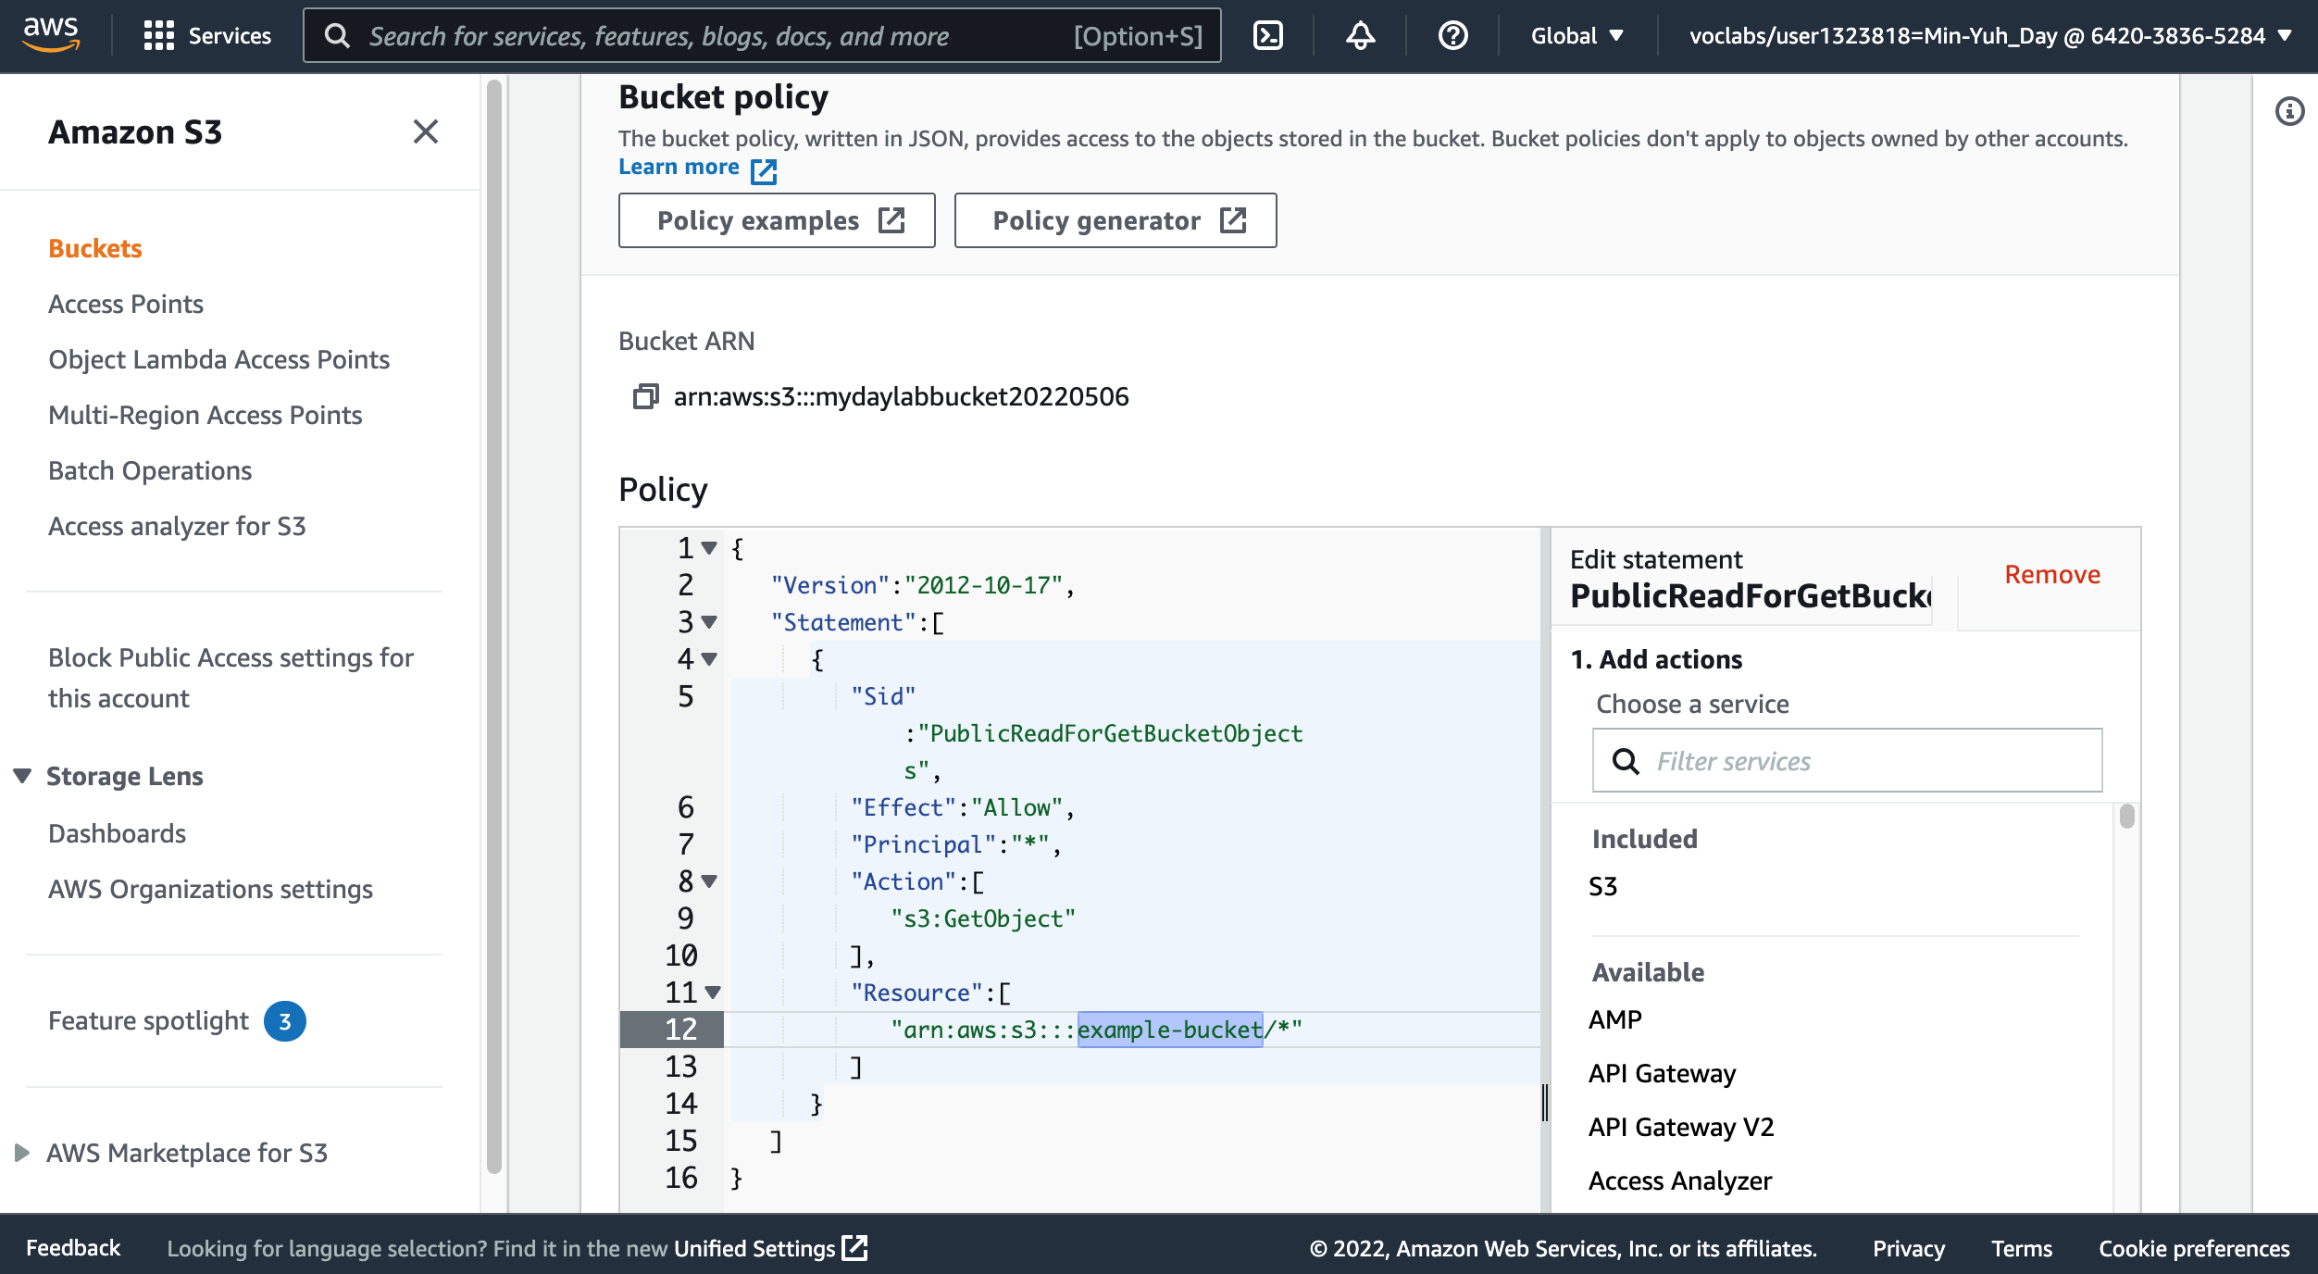
AWS Hands-on : Using S3 Service for XBRL Cloud Storage
13. In the policy, replace example-bucket with the name of your bucket.
13
Source: AWS Academy Introduction to Cloud: Semester 1, https://awsacademy.instructure.com/courses/18745

Slide 50
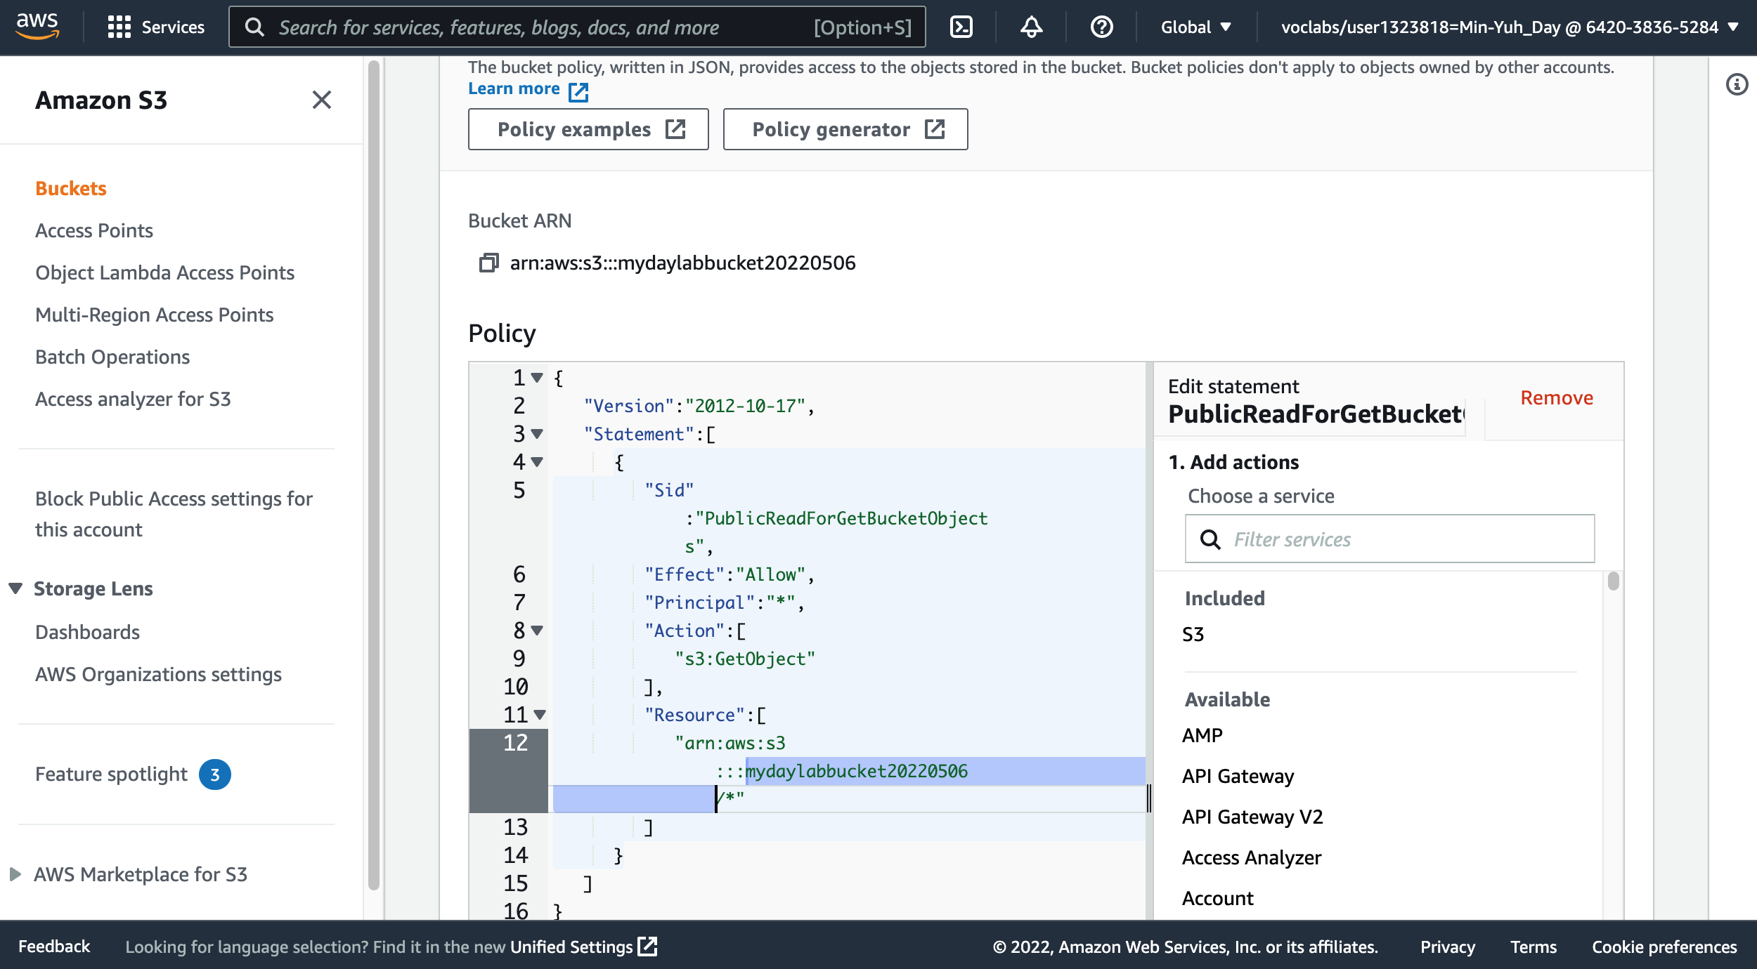
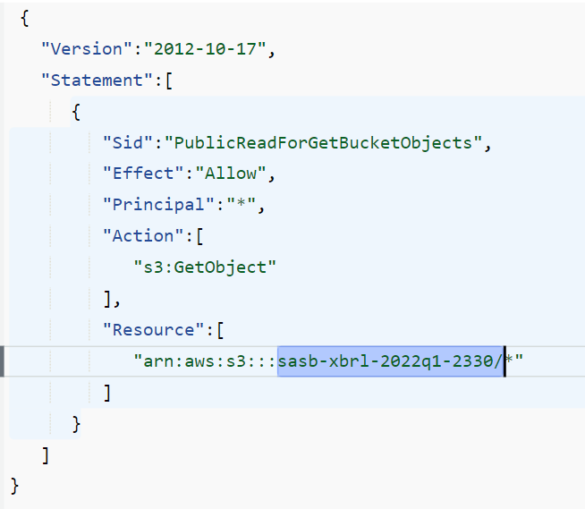
AWS Hands-on : Using S3 Service for XBRL Cloud Storage
13. In the policy, replace example-bucket with the name of your bucket.
{
"Version":"2012-10-17",
"Statement":[
{
"Sid":"PublicReadForGetBucketObjects",
"Effect":"Allow",
"Principal":"*",
"Action":[
"s3:GetObject"
],
"Resource":[
"arn:aws:s3:::sasb-xbrl-2330/*"
]
}
]
}
13
Source: AWS Academy Introduction to Cloud: Semester 1, https://awsacademy.instructure.com/courses/18745

Slide 51
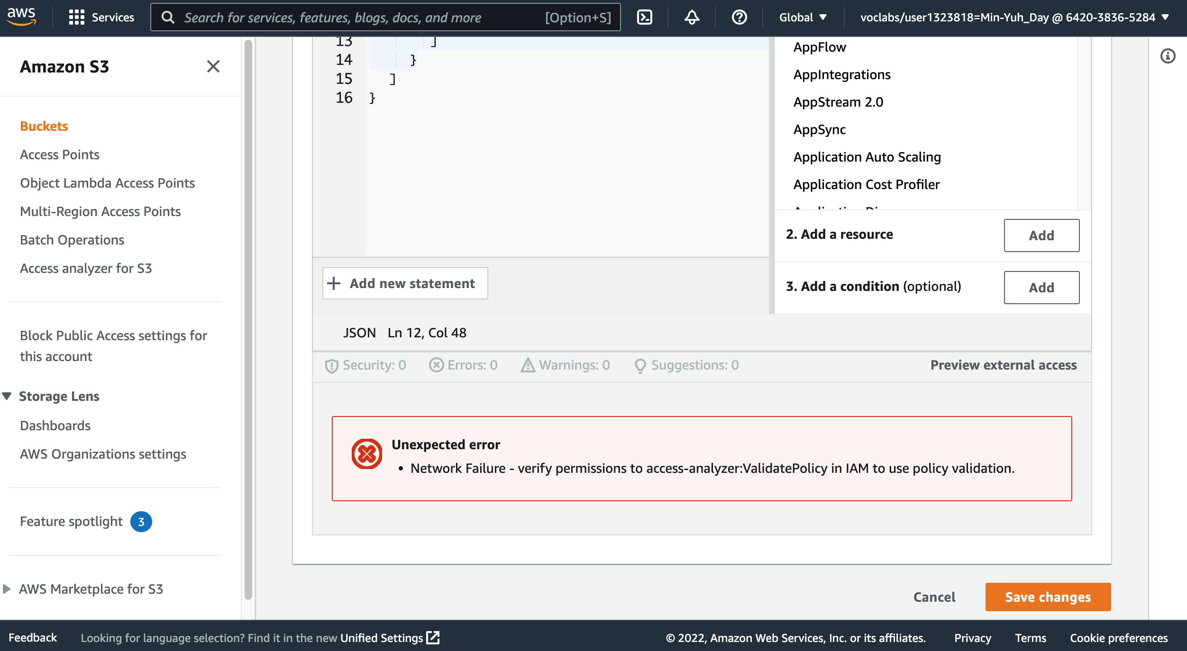
AWS Hands-on : Using S3 Service for XBRL Cloud Storage
14. At the bottom of the page, choose Save changes.
14
Source: AWS Academy Introduction to Cloud: Semester 1, https://awsacademy.instructure.com/courses/18745

Slide 52
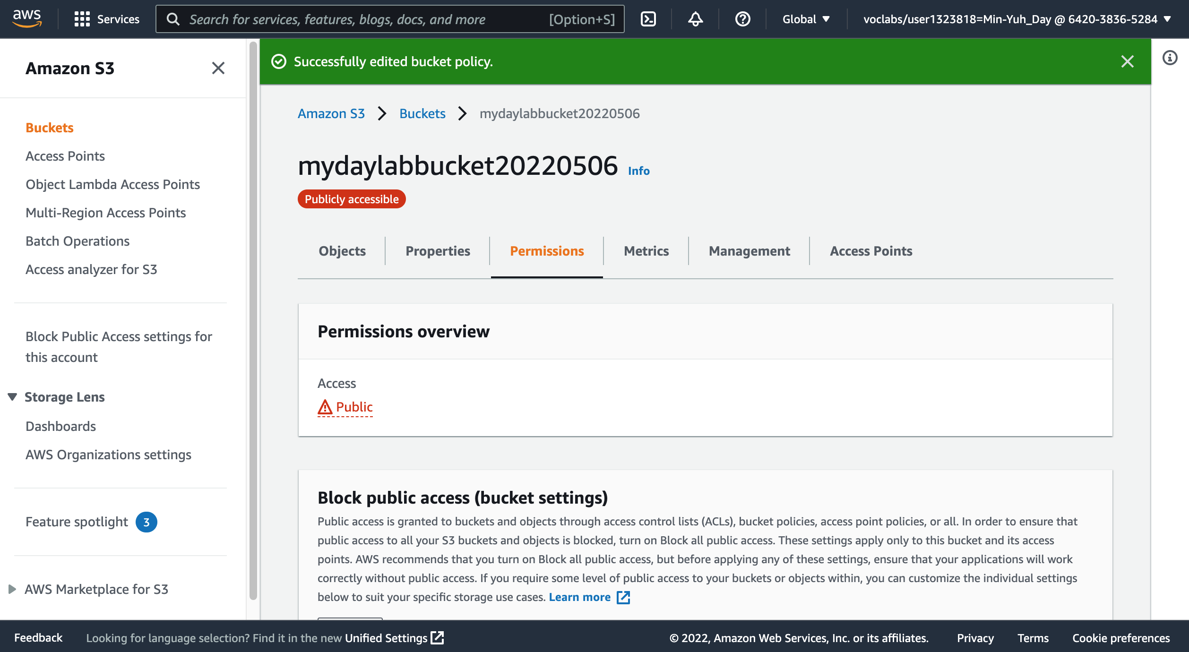
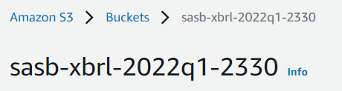
AWS Hands-on : Using S3 Service for XBRL Cloud Storage
Source: AWS Academy Introduction to Cloud: Semester 1, https://awsacademy.instructure.com/courses/18745

Slide 53
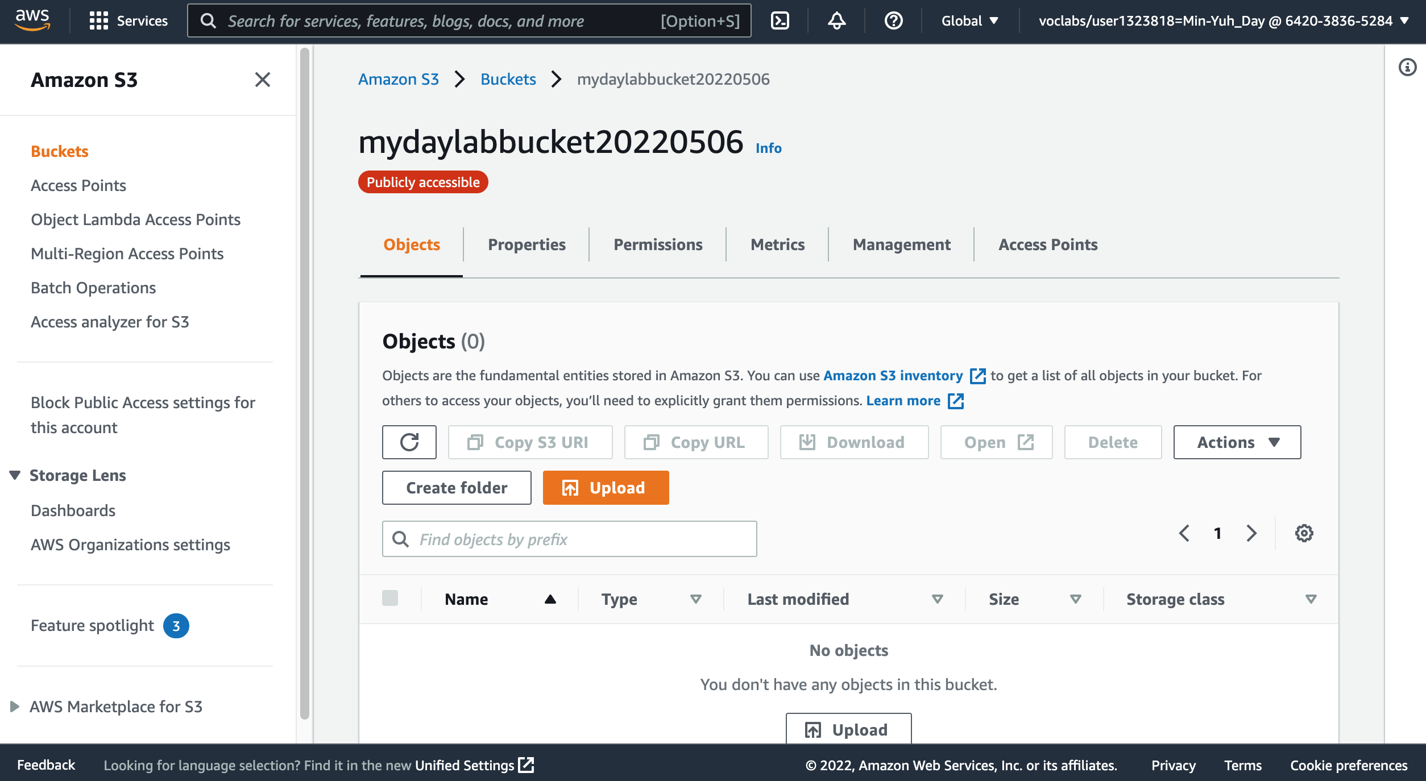
AWS Hands-on : Using S3 Service for XBRL Cloud Storage
17
17. In the console, choose the Objects tab.
18
18. Upload the SASB_TC-SC_TSMC.xmlfile to your bucket. Choose Upload.
Source: AWS Academy Introduction to Cloud: Semester 1, https://awsacademy.instructure.com/courses/18745

Slide 54
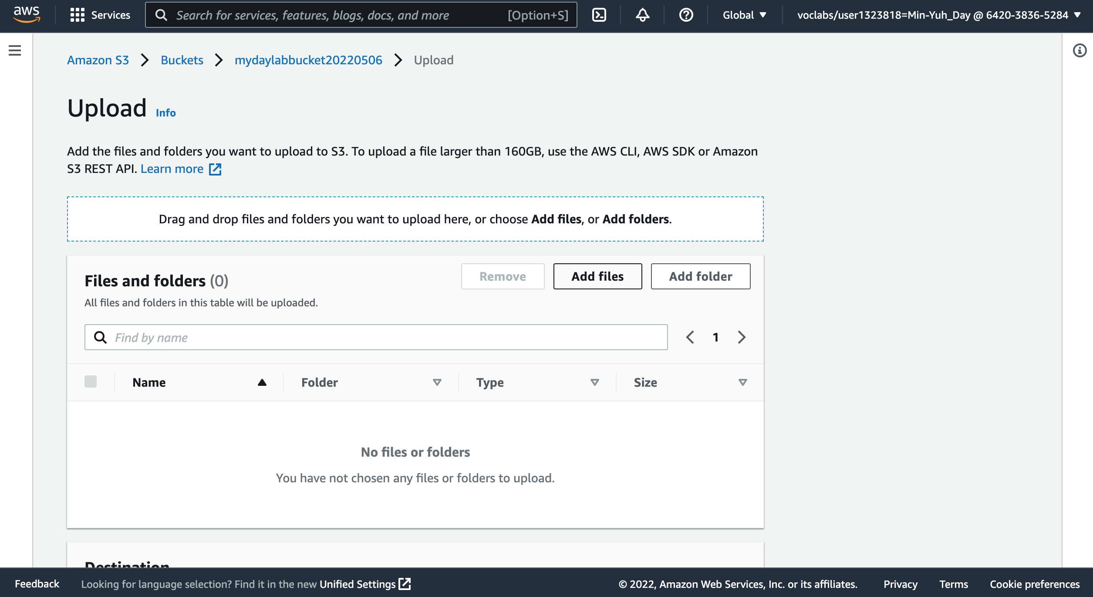
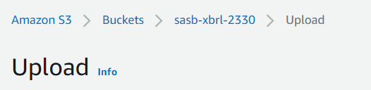
AWS Hands-on : Using S3 Service for XBRL Cloud Storage
18
18 Upload SASB_TC-SC_TSMC.xml file to your bucket.
Choose Upload.
Drag and drop Upload SASB_TC-SC_TSMC.xml l file onto the upload page. An alternative is to choose Add files, navigate to the file, and choose Open.
Source: AWS Academy Introduction to Cloud: Semester 1, https://awsacademy.instructure.com/courses/18745

Slide 55
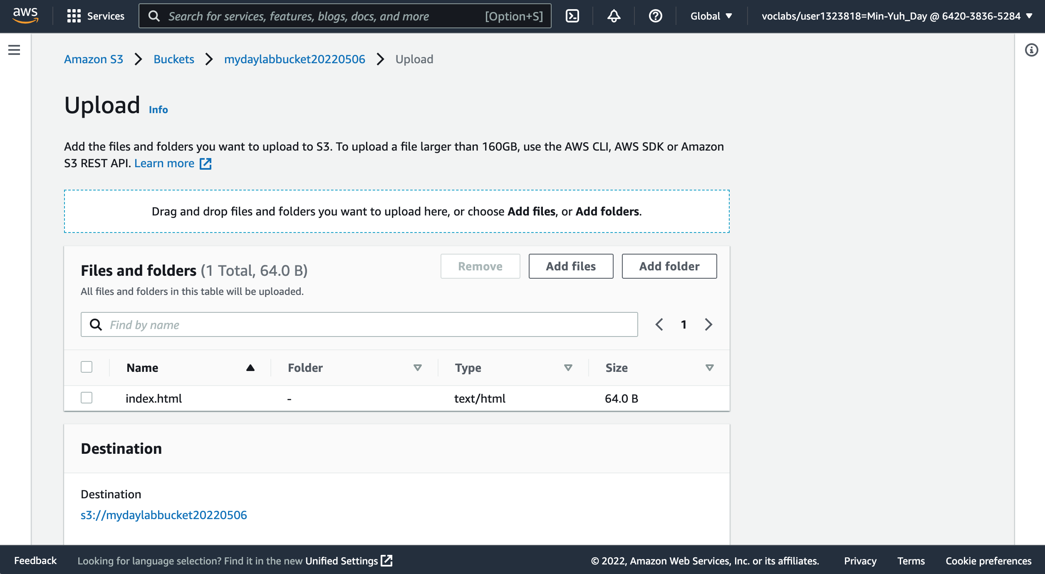
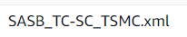
AWS Hands-on : Using S3 Service for XBRL Cloud Storage
18
18 Upload Upload SASB_TC-SC_TSMC.xml file to your bucket.
Choose Upload.
Drag and drop the Upload SASB_TC-SC_TSMC.xml file onto the upload page. An alternative is to choose Add files, navigate to the file, and choose Open.
Source: AWS Academy Introduction to Cloud: Semester 1, https://awsacademy.instructure.com/courses/18745

Slide 56
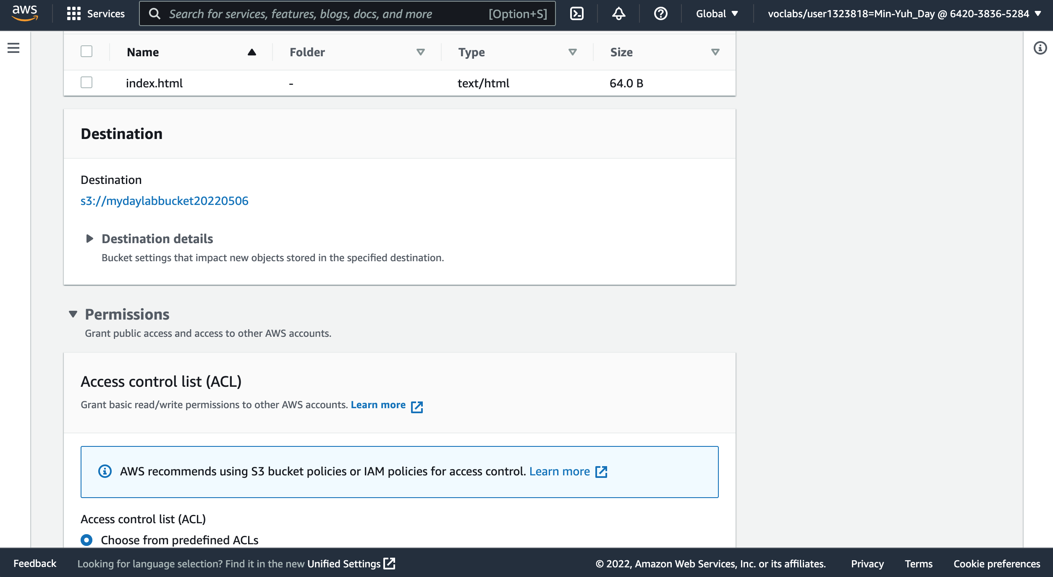
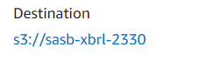
AWS Hands-on : Using S3 Service for XBRL Cloud Storage
19
Expand the Permissions section.
Source: AWS Academy Introduction to Cloud: Semester 1, https://awsacademy.instructure.com/courses/18745

Slide 57
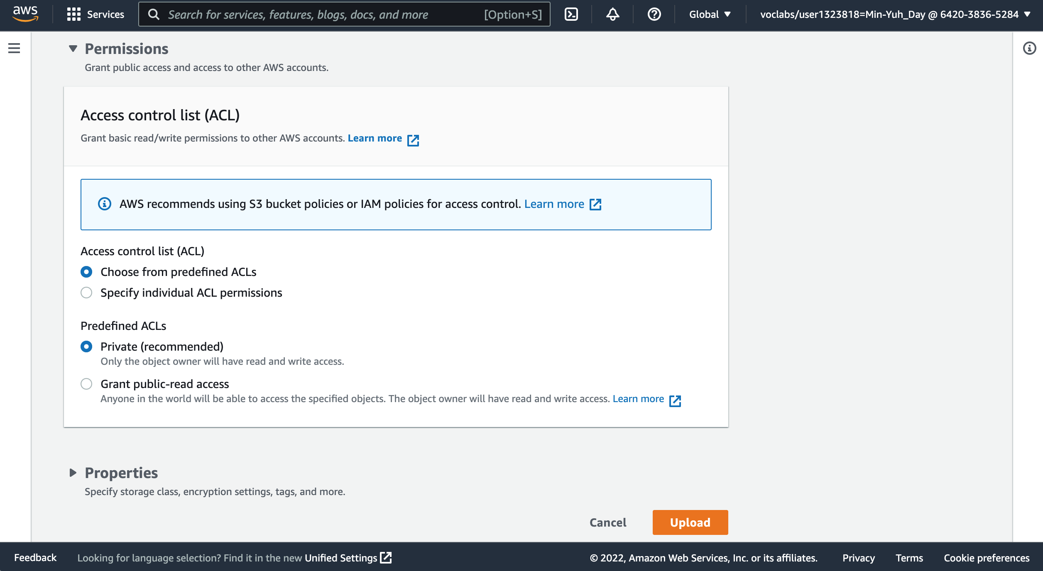
AWS Hands-on : Using S3 Service for XBRL Cloud Storage
20
20. Under Predefined ACLs, select Grant public-read access.
Source: AWS Academy Introduction to Cloud: Semester 1, https://awsacademy.instructure.com/courses/18745

Slide 58
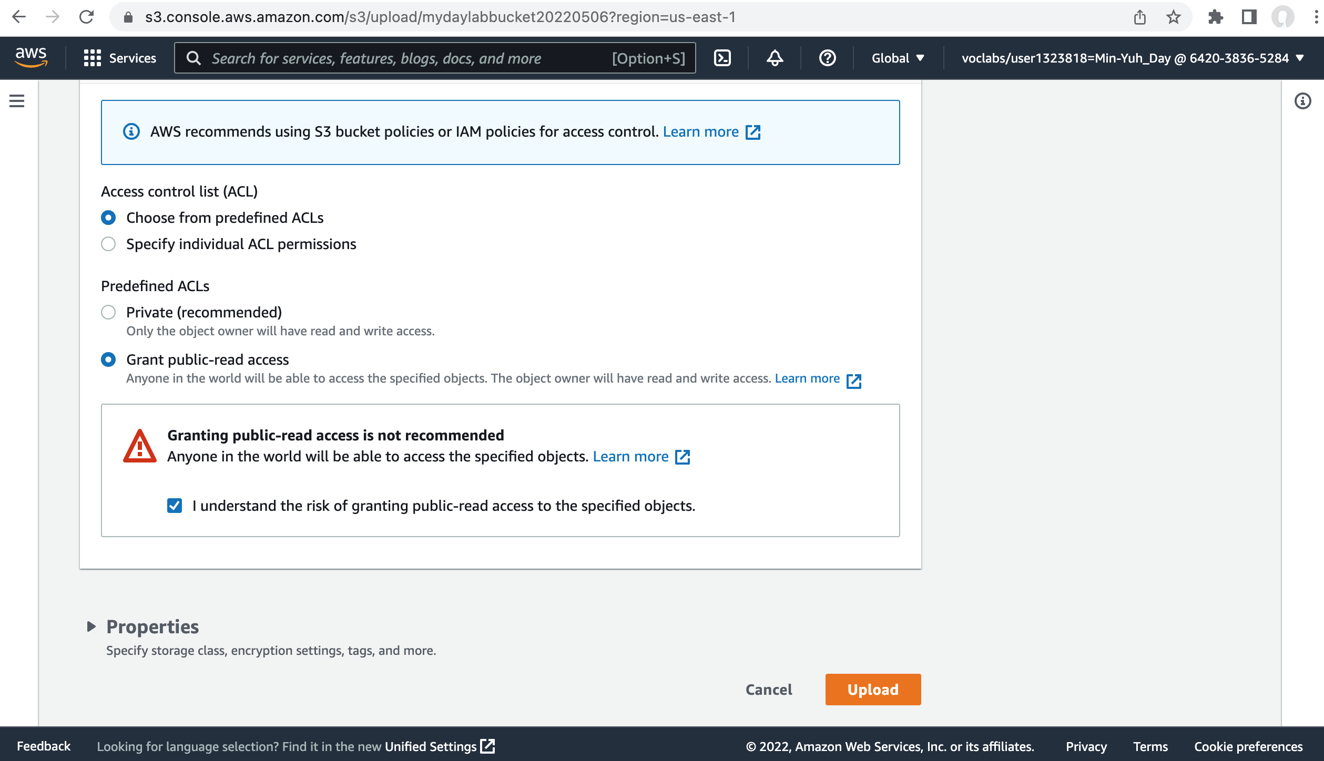
AWS Hands-on : Using S3 Service for XBRL Cloud Storage
20. Under Predefined ACLs, select Grant public-read access.
A warning message similar to Granting public-read access is not recommend appears below the setting you selected.
20
21
21. Below the warning, check the box next to I understand....
22. At the bottom of the page, choose Upload.
22
Source: AWS Academy Introduction to Cloud: Semester 1, https://awsacademy.instructure.com/courses/18745

Slide 59
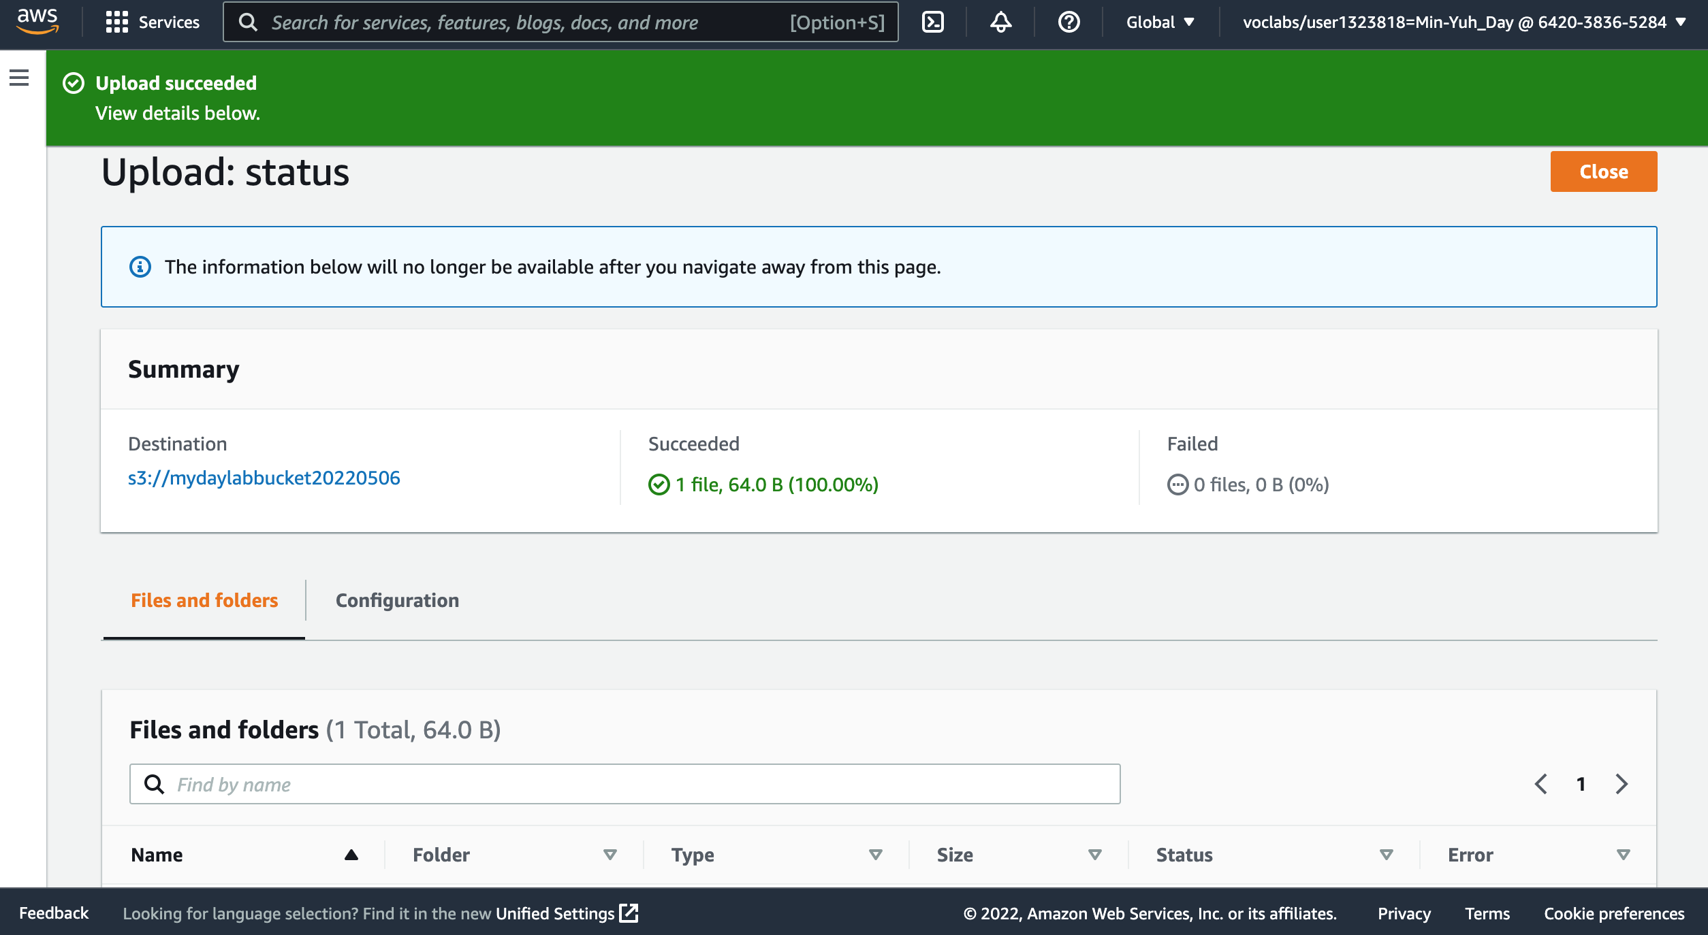
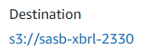
AWS Hands-on : Using S3 Service for XBRL Cloud Storage
23
24. Choose Close.
Source: AWS Academy Introduction to Cloud: Semester 1, https://awsacademy.instructure.com/courses/18745

Slide 60
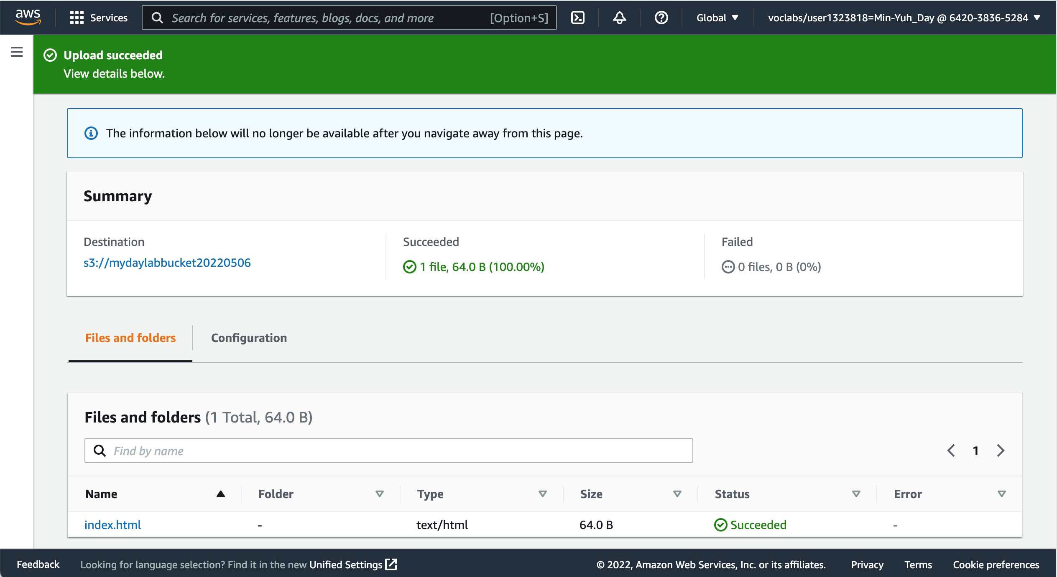
AWS Hands-on : Using S3 Service for XBRL Cloud Storage
Source: AWS Academy Introduction to Cloud: Semester 1, https://awsacademy.instructure.com/courses/18745

Slide 61

AWS Hands-on : Using S3 Service for XBRL Cloud Storage
The SASB_TC-SC_TSMC.xml file appears in the Objects list.
Source: AWS Academy Introduction to Cloud: Semester 1, https://awsacademy.instructure.com/courses/18745

Slide 62
永續報告 XBRL 雲端架構圖 (AWS)
儲存非結構化之企業永續報告書(PDF 檔)
儲存經標註後的XBRL檔案
資料來源：This Research

Slide 63
永續報告 XBRL 雲端儲存
Amazon S3可做為資料前處理的非結構化企業永續報告書(.pdf)的儲存以及經標註後的XBRL 的檔案儲存。
雲端儲存不僅可以將資料拓展給其他經授權的使用者使用，同時亦可以講低本地端的暫存空間，減少其基礎設施的儲存與成本。
未來趨勢與研究方向：預計將Amazon S3串聯AWS其他服務(e.g. Lambda, API Gateway) 做為後續部屬完善整個雲端架構之用，並同時根據不同使用者的權限做好更有效的存取控制。

Slide 64
References
https://aws.amazon.com/certification/
https://www.aws.training/
https://aws.amazon.com/training/awsacademy/
https://aws.amazon.com/education/awseducate/
AWS Academy Introduction to Cloud: Semester 1
https://awsacademy.instructure.com/courses/18745
AWS Certified Cloud Practitioner
https://aws.amazon.com/certification/certified-cloud-practitioner/
AWS Certified Solutions Architect – Associate
https://aws.amazon.com/certification/certified-solutions-architect-associate/
AWS Cloud Practitioner Essentials (Second Edition)
https://aws.amazon.com/training/course-descriptions/cloud-practitioner-essentials/
Architecting on AWS
https://aws.amazon.com/training/course-descriptions/architect/

Slide 65
雲端儲存與永續資訊 Cloud Storage and Sustainability Information
2022 ESG 高鋒會 永續資訊揭露案例及雲端儲存
Q & A
Time: 2022/6/25 (Sat.) 9:40-10:15 Place: 台北世貿一館1樓B區 ESG沙龍 (B536)
戴敏育 副教授
Min-Yuh Day, Ph.D, Associate Professor
國立臺北大學 資訊管理研究所
Institute of Information Management, National Taipei University
https://web.ntpu.edu.tw/~myday
2022-06-25

Slide 66


Thank You
意見調查
QR code
（本會收到您的投影片後，將會加上問卷QR碼）

